Slide 1
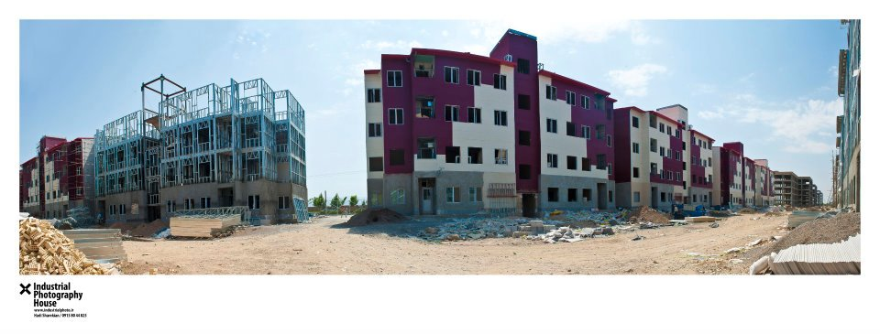


Pre-Engineered (LGS) Structures.
Dr. Bilal Ahmad
Executive Director
PEBi

Slide 3
STATISTICS
Shortage of housing units in 2009 = 8m Units
Current Shortage of housing units = 9-10 Million Units
Demand is increasing by 350,000/Annum
Current Supply is 150,000/Annum
Targeted 5 M houses in 5 years =>1 M houses/Year
1125 Million S.ft to be constructed every year
Published in Dawn, August 19, 2018

Slide 4
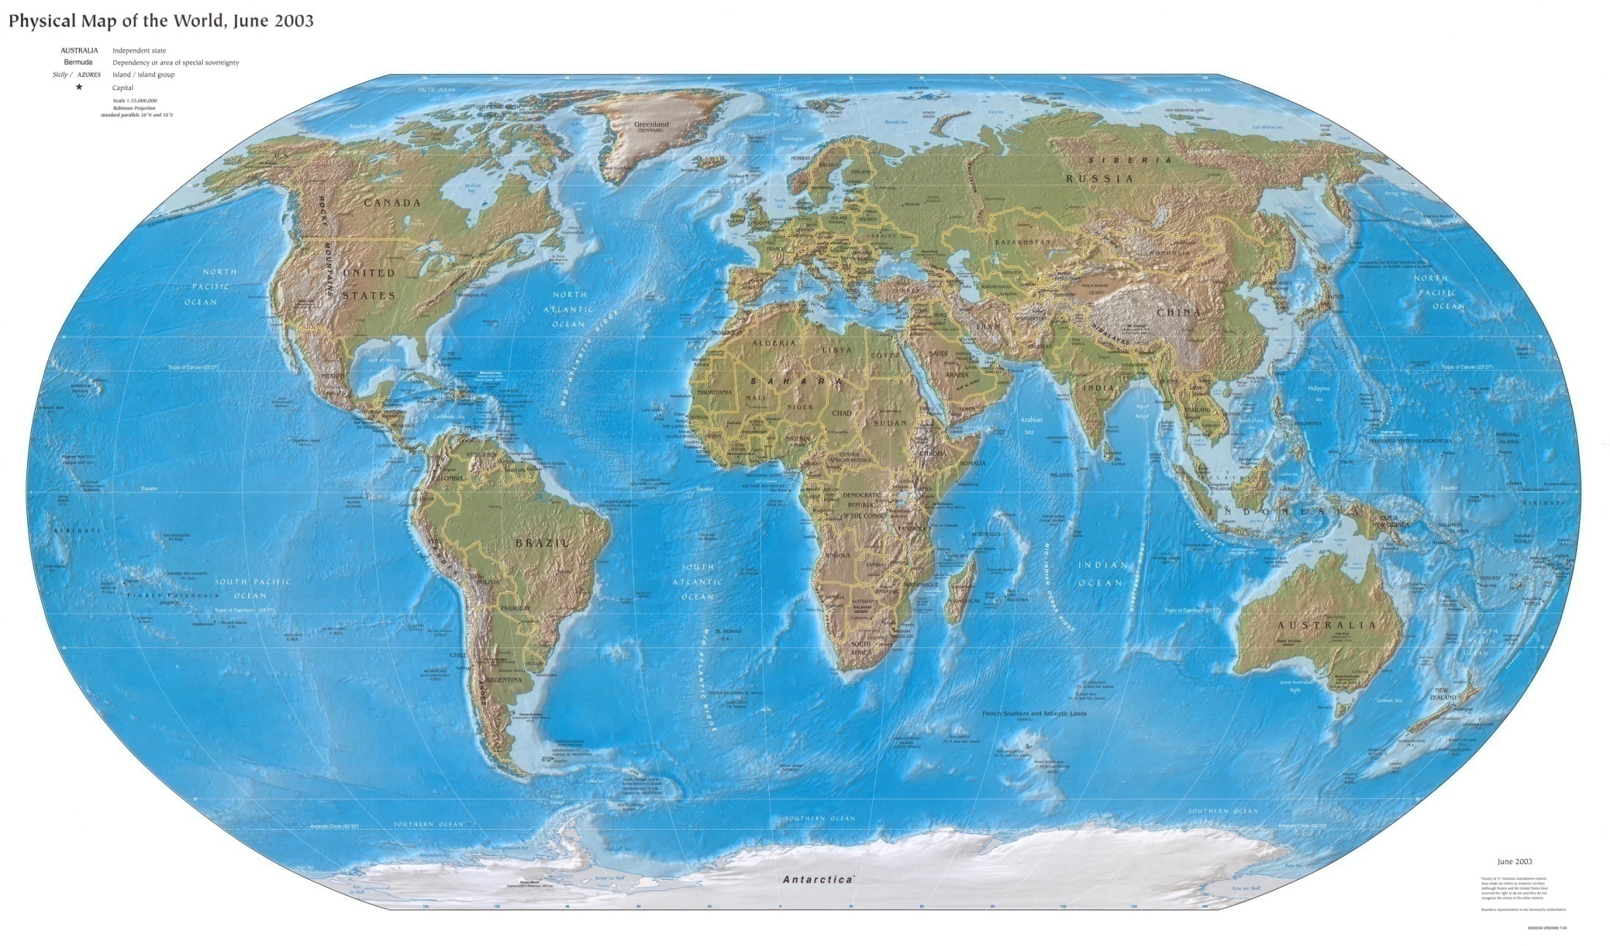


FRAMECAD/Pinnacle Exporting Innovation to the World
Established more than 150 factories worldwide in over 65 countries

Slide 5

Fundamental questions to this technology
Is it workable???
How does it differ?
Do we really need it?

Slide 6
TECHNOLOGY
Limitations of conventional construction technology
Time delays
Inter-dependency of activities
Cost Variations at Completion of Project
More stakeholders, difficult to control Quality
High maintenance Cost due to Fungus and Seepage issues
Foundation Problem due to deprived soil condition
Poor Energy Efficiency
Less Environment Friendly

Slide 7
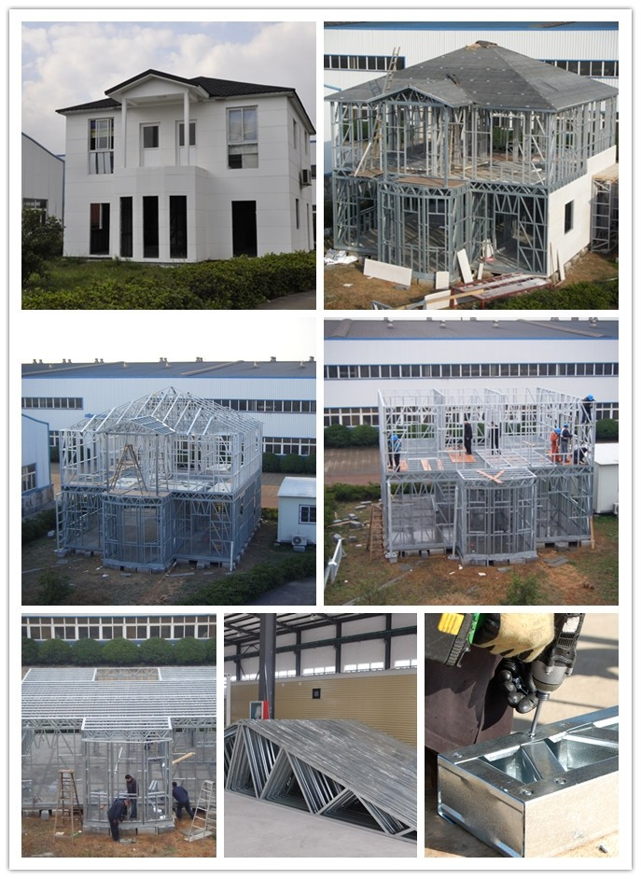
What is smart Alternate then ?
Pre-Engineered Light gauge steel structures

Slide 8
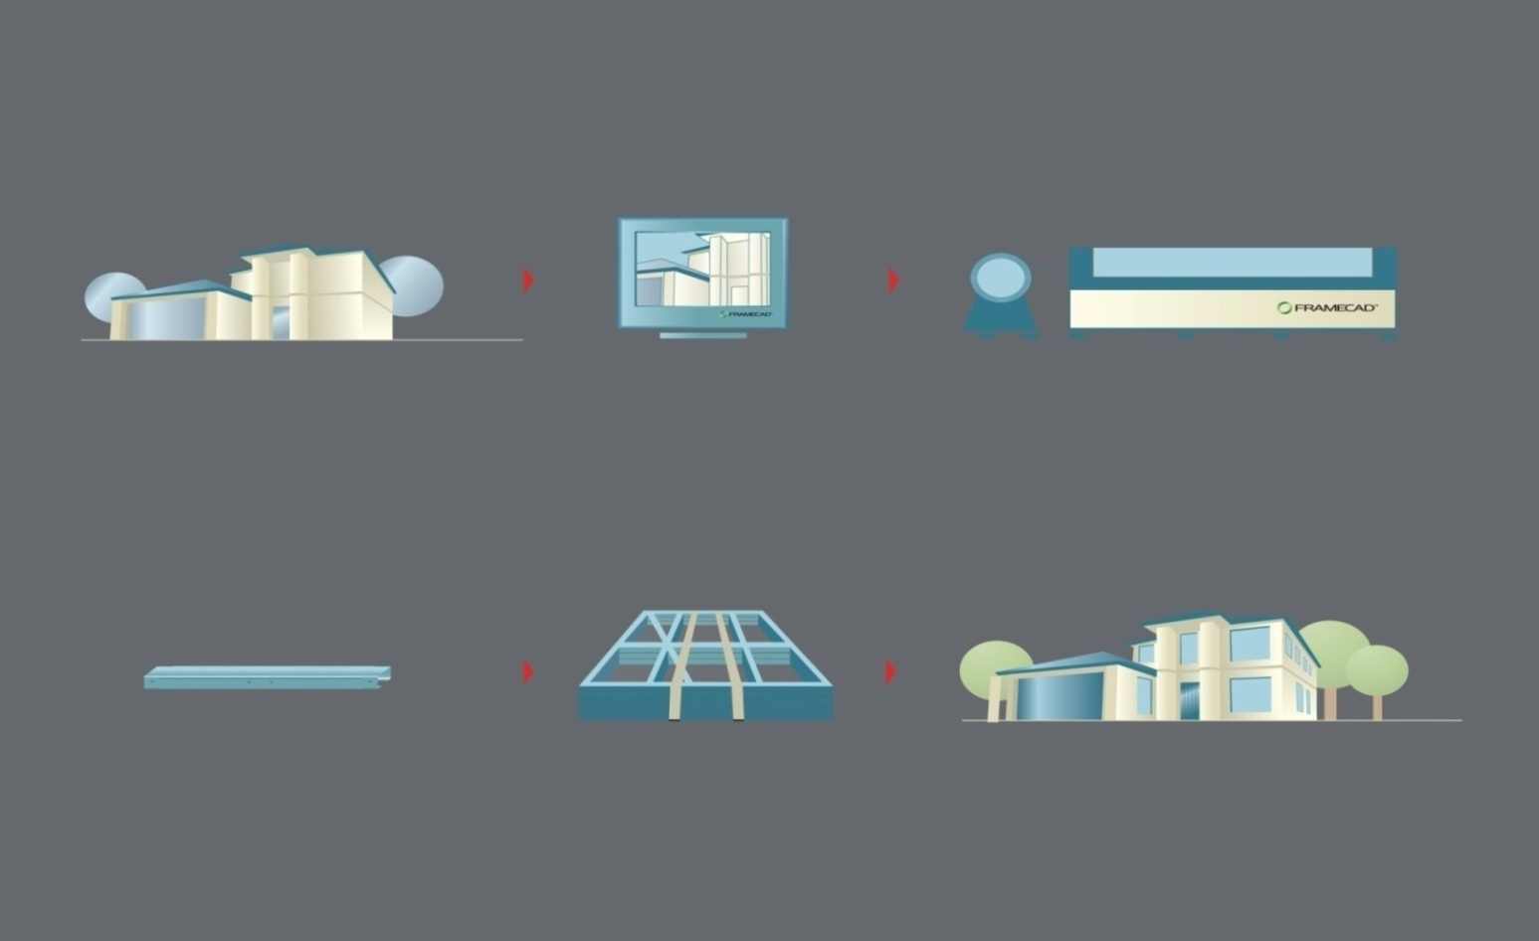

Flow of Project
3D Modelling
Engineering & Detailing
Manufacture
Individual
Components
Assembly
Construction
www.framecad.com.cn

Slide 9
MATERIAL AND SPECIFICATIONS

Slide 10
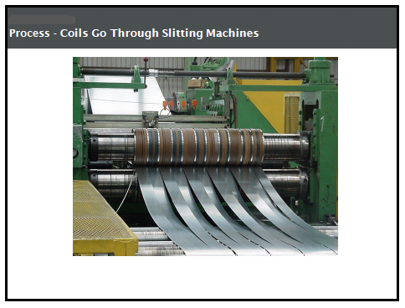
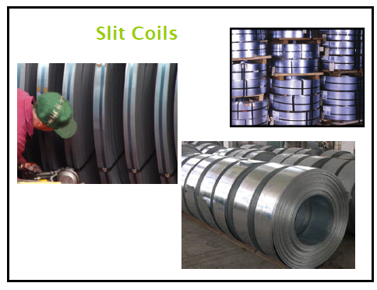
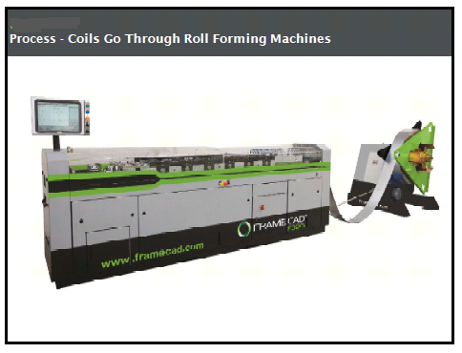
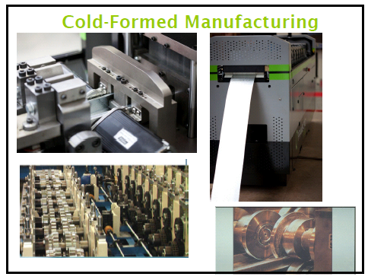

Slide 11
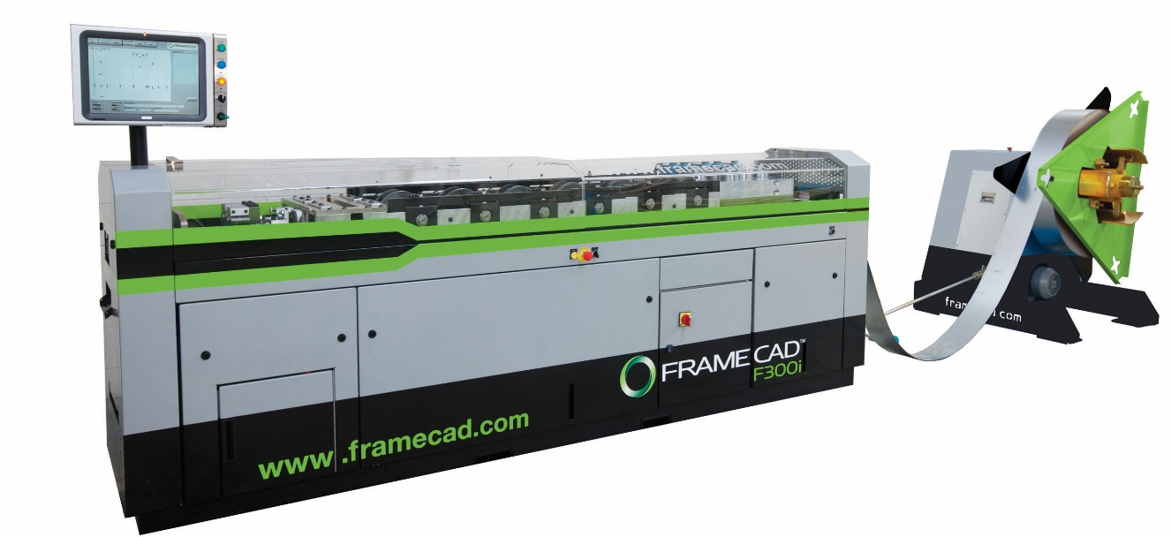
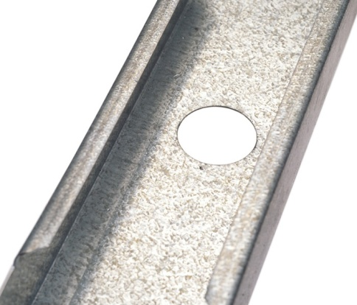
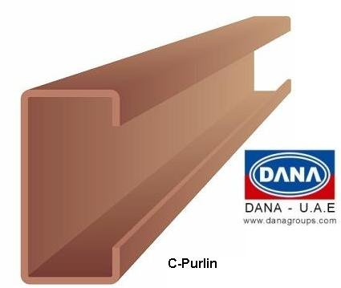
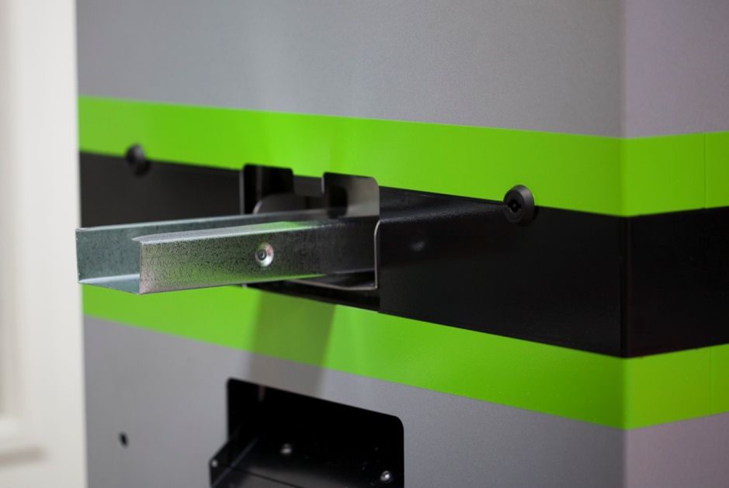
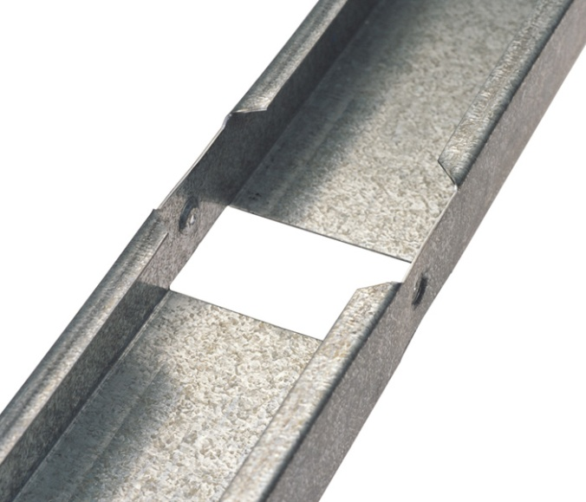
Manufacturing
Notes:
Some of the equipment that might be seen in a roll-forming facility.

Slide 12
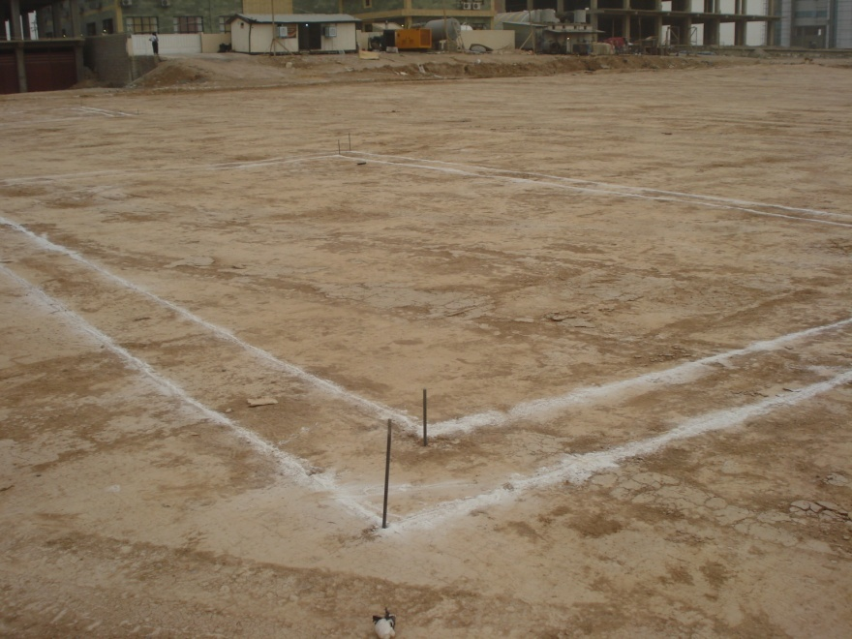
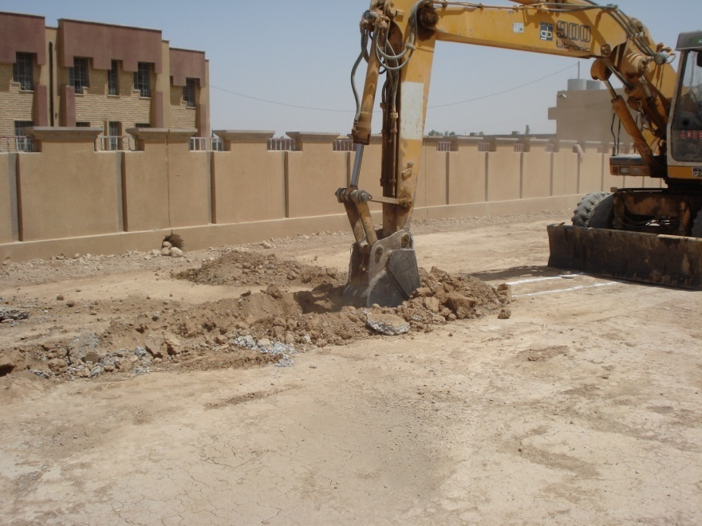
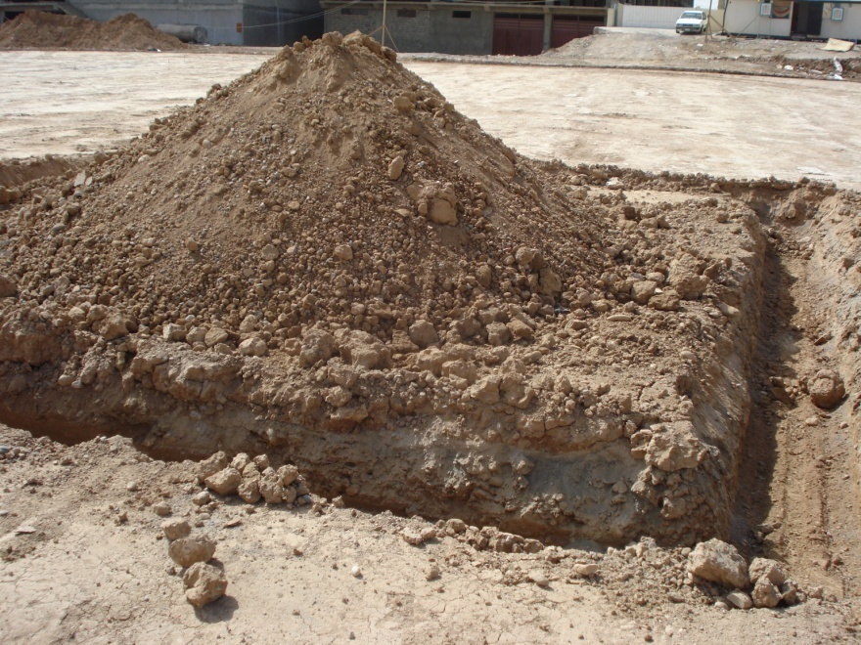
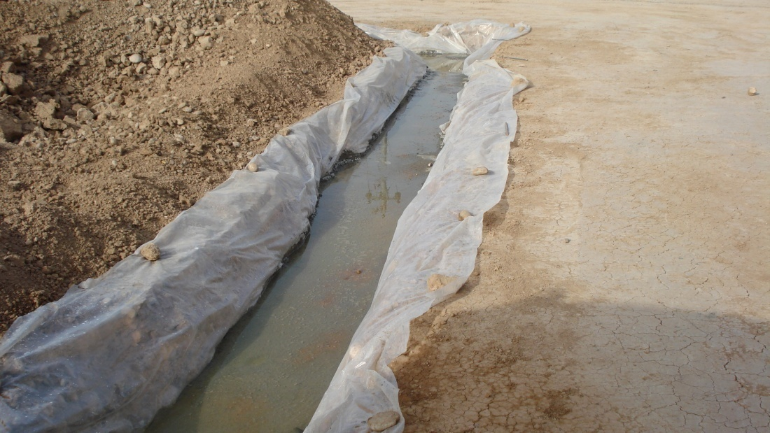
Foundation

Slide 13
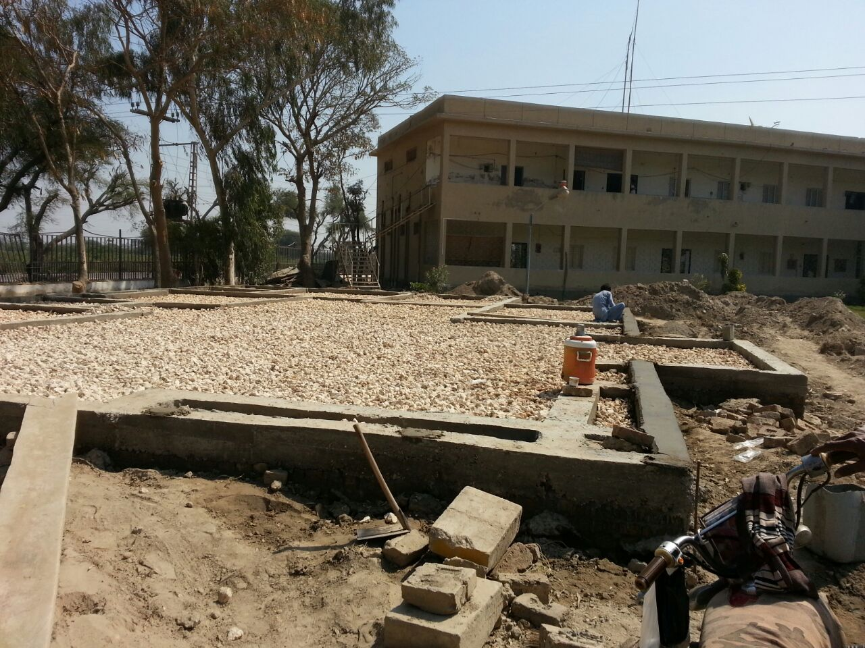
Foundation

Slide 14
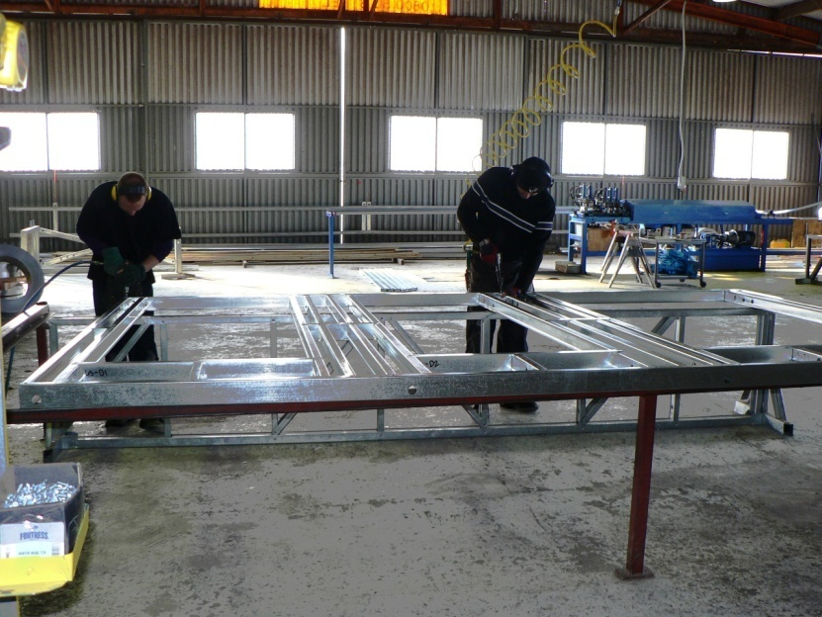
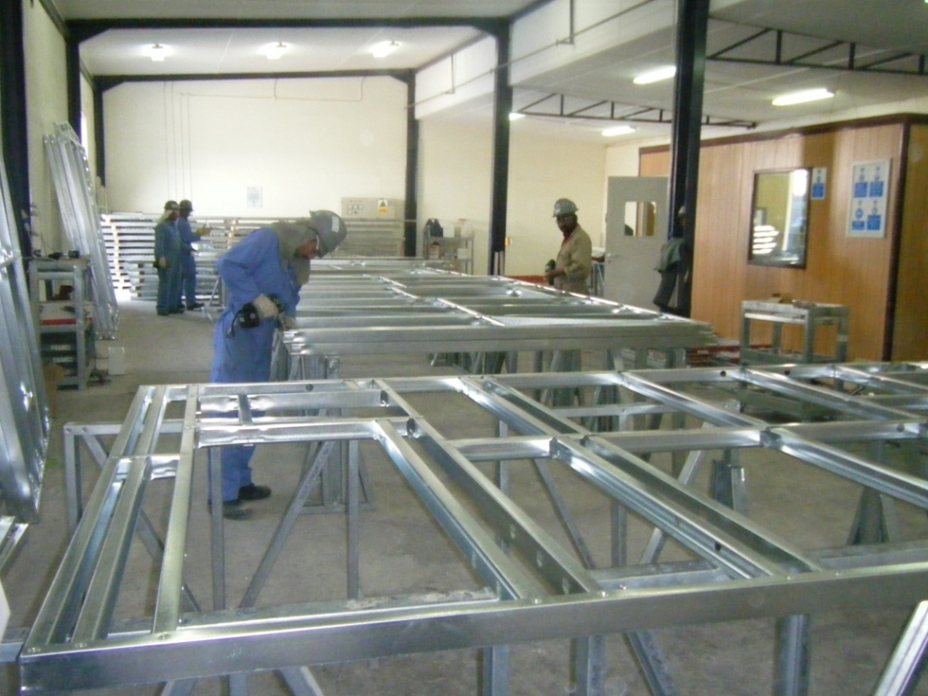
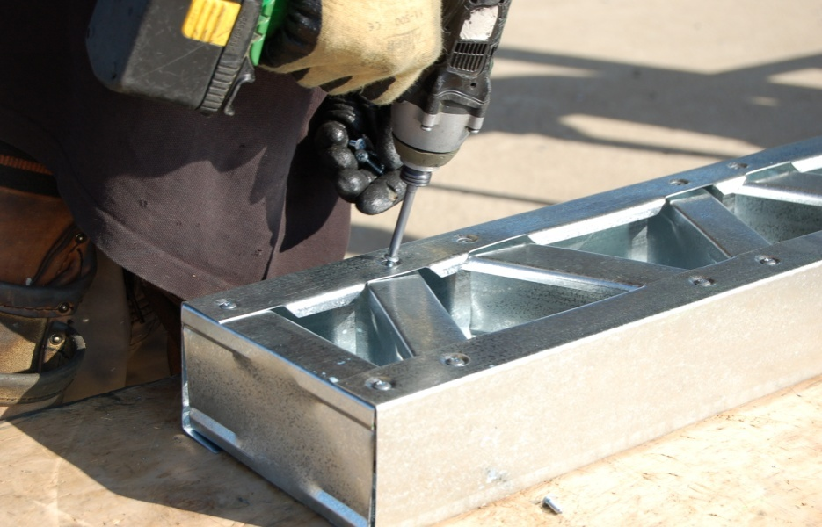
Frame Assembly in Ware House

Slide 15
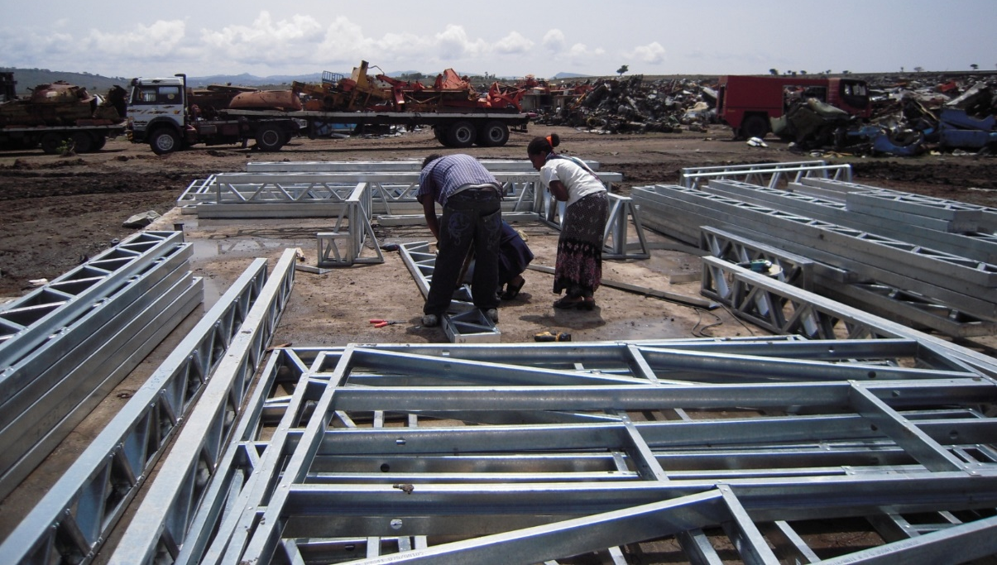
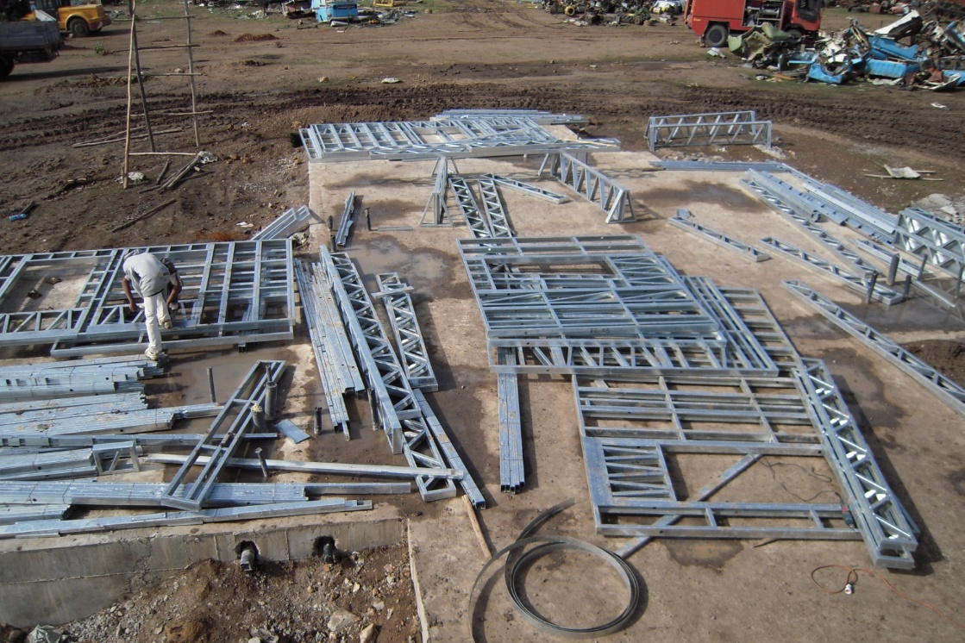
Frame Assembly at Site

Slide 16
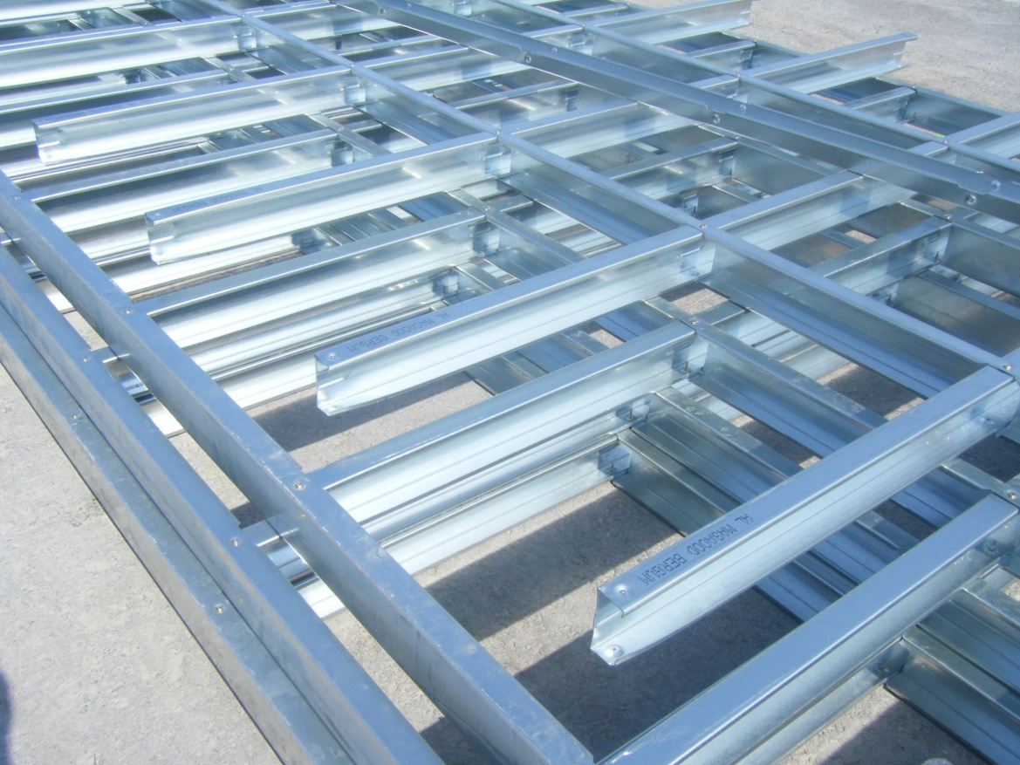
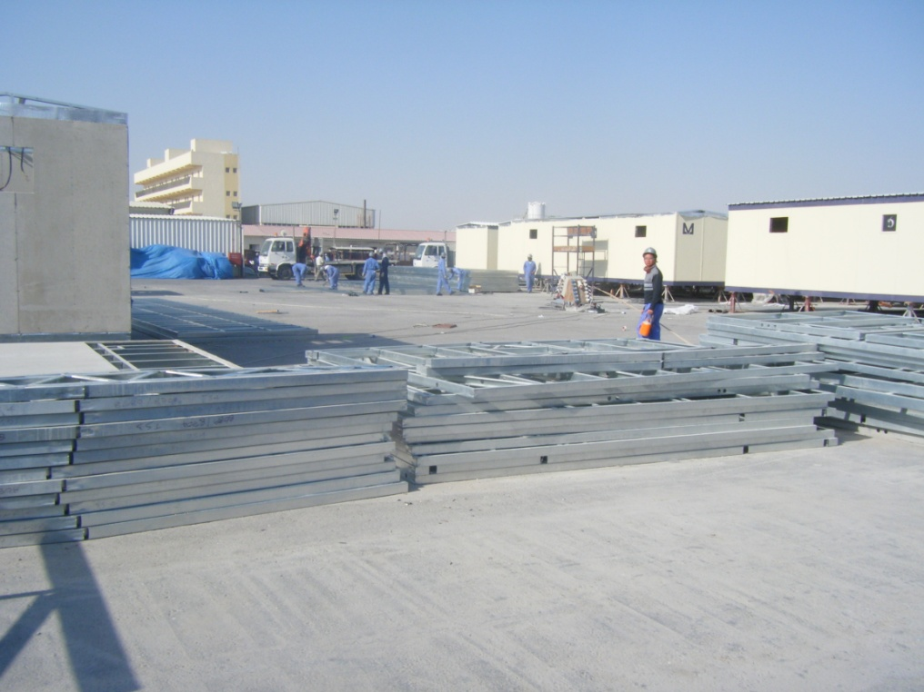
Stacking at Site

Slide 17
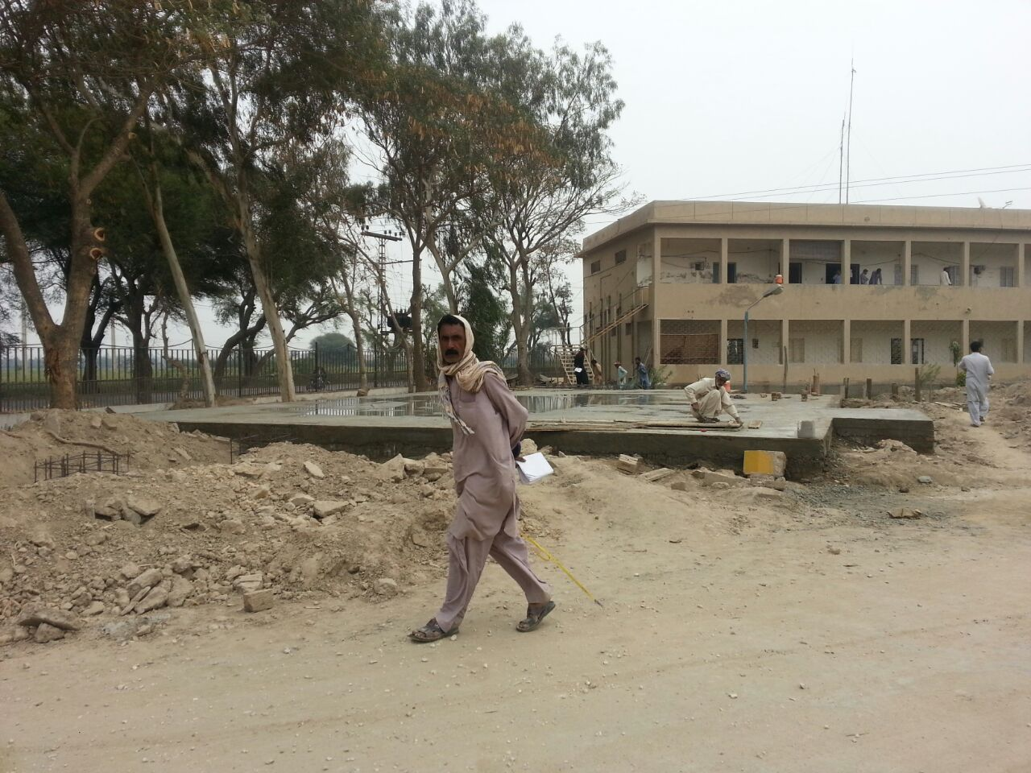
Lean Flooring

Slide 18
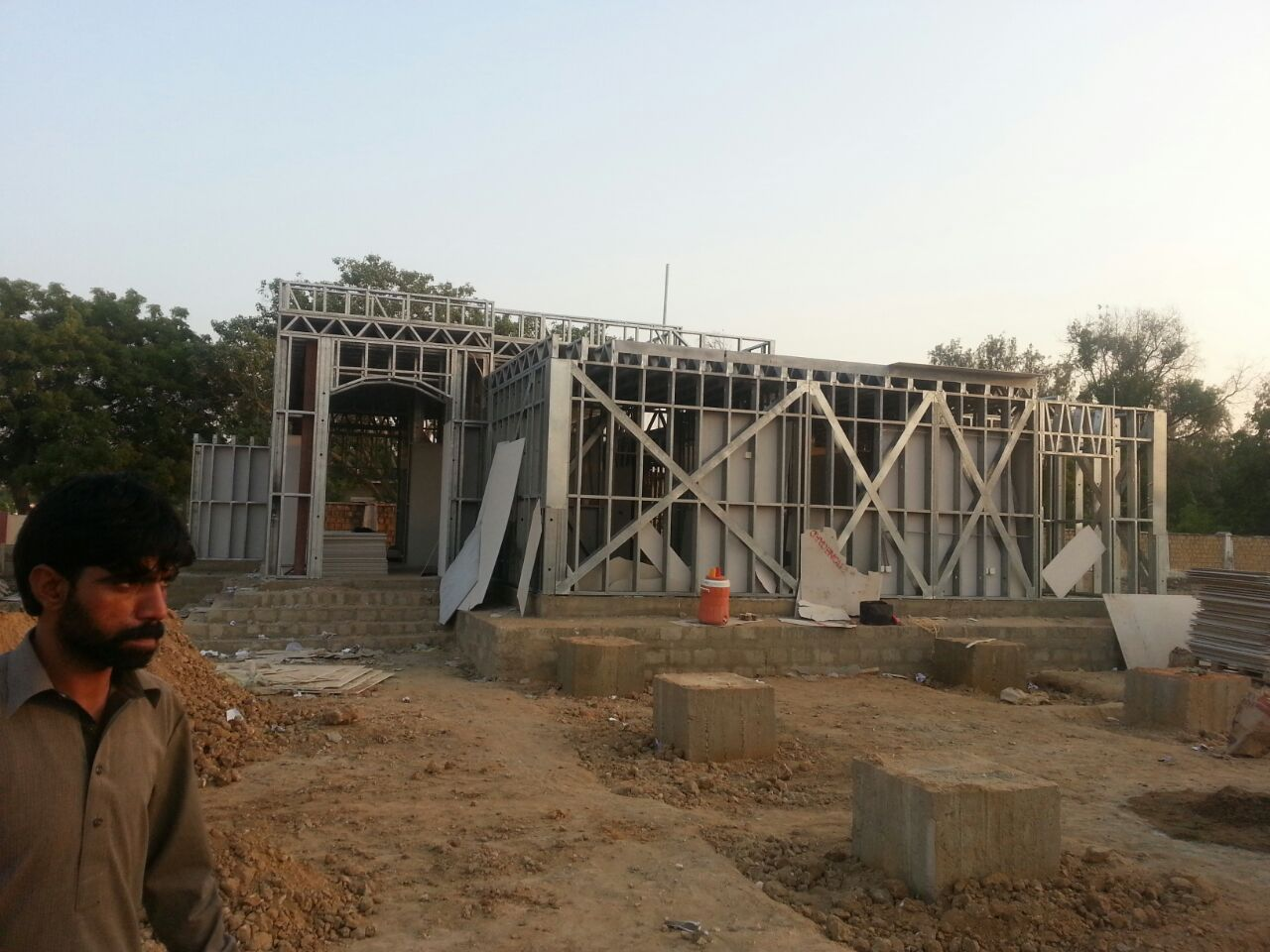
STRUCTURE WORK

Slide 19
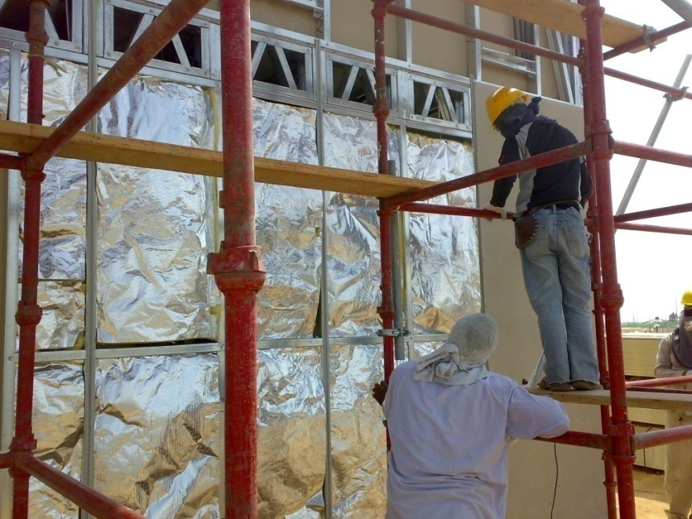
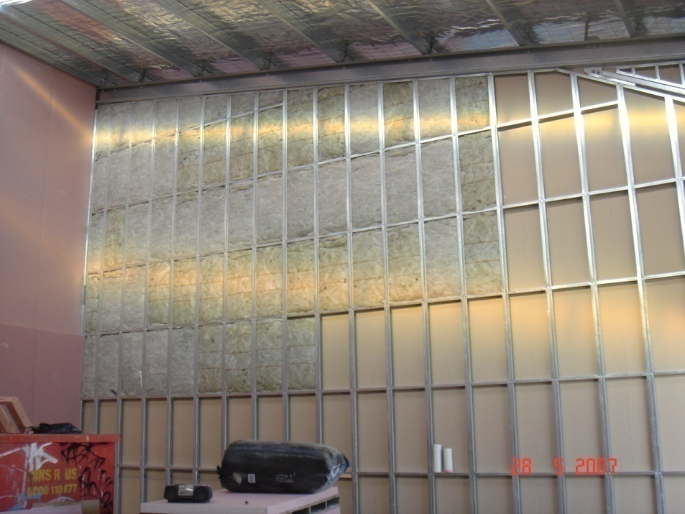
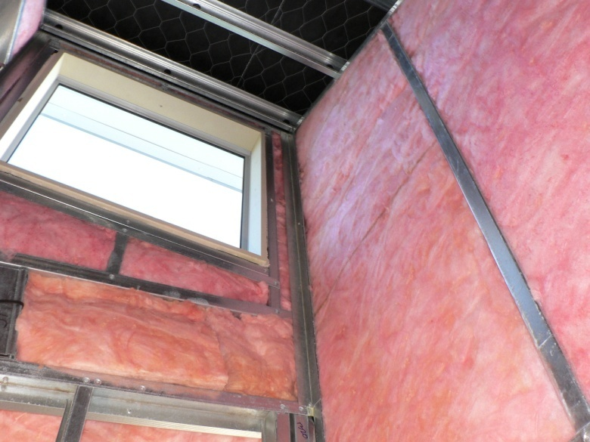
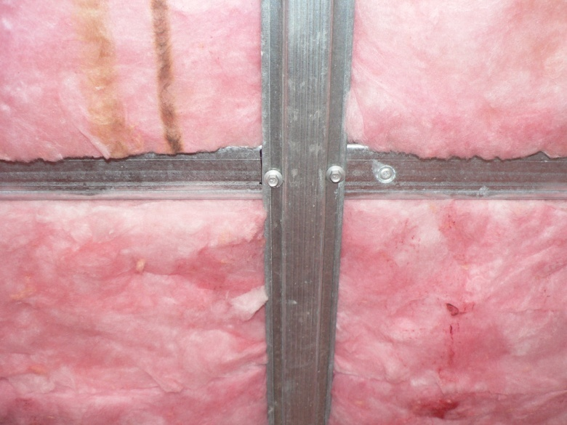
Insulation

Slide 20
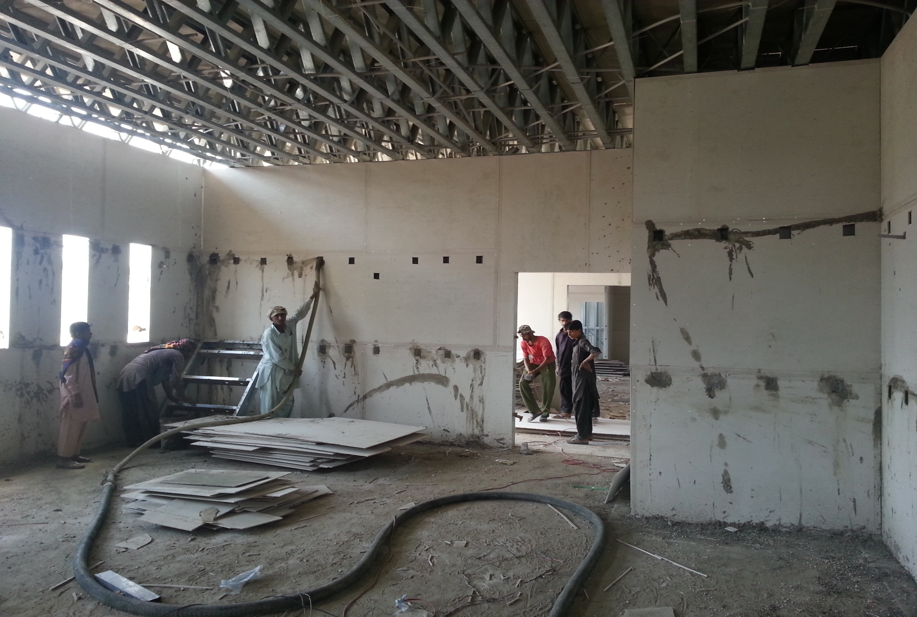
CLADDING & INFILL

Slide 21
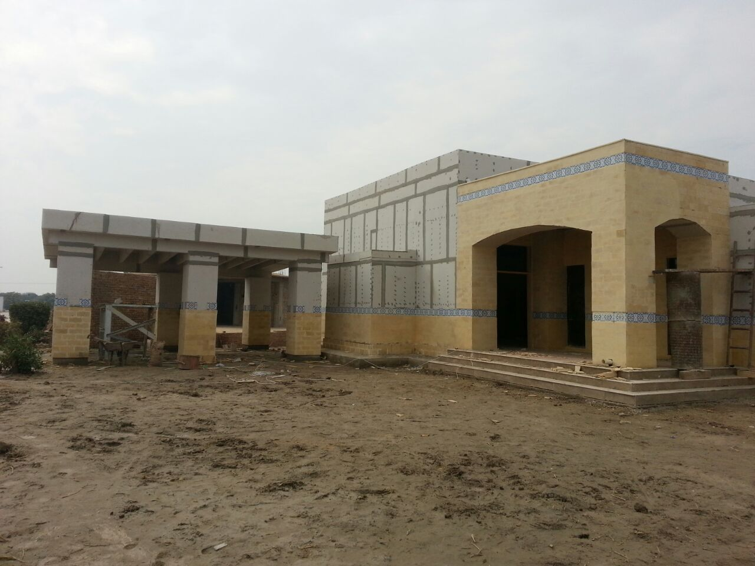
JOINTING/ FINISHING

Slide 22
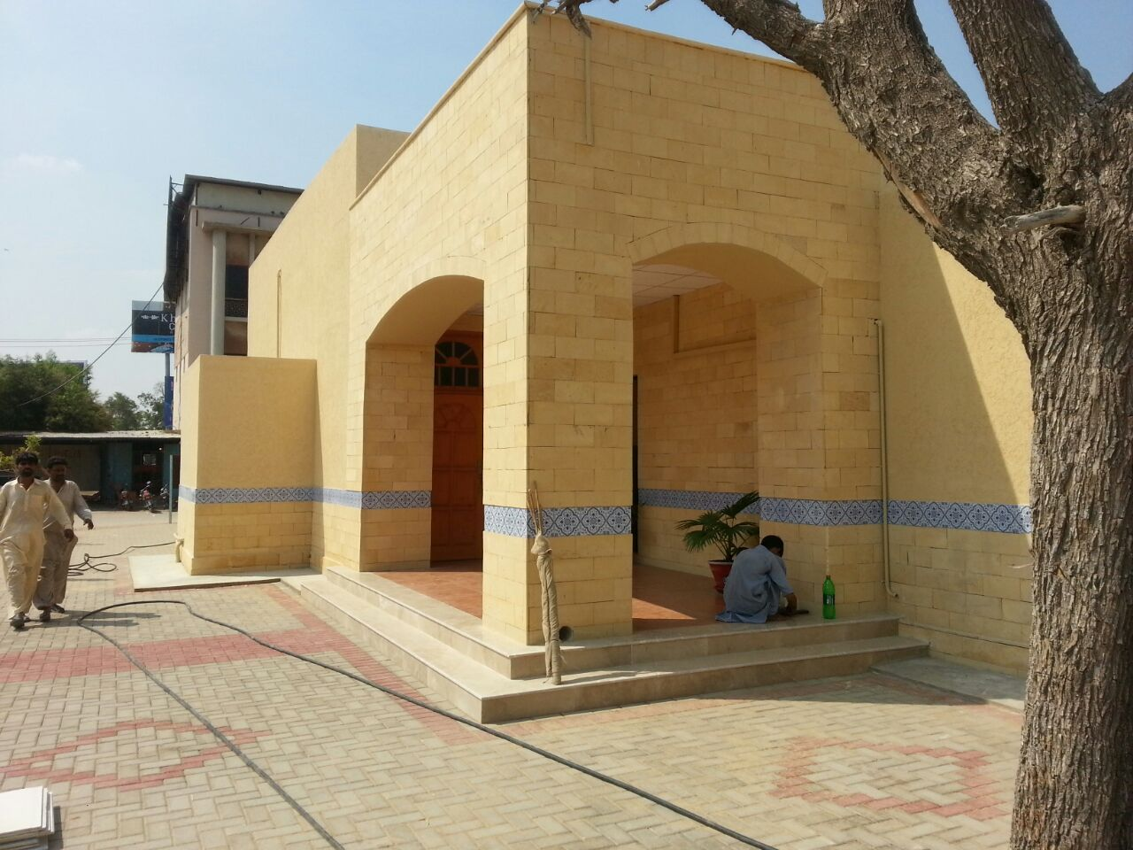
FINISHES WORK

Slide 23
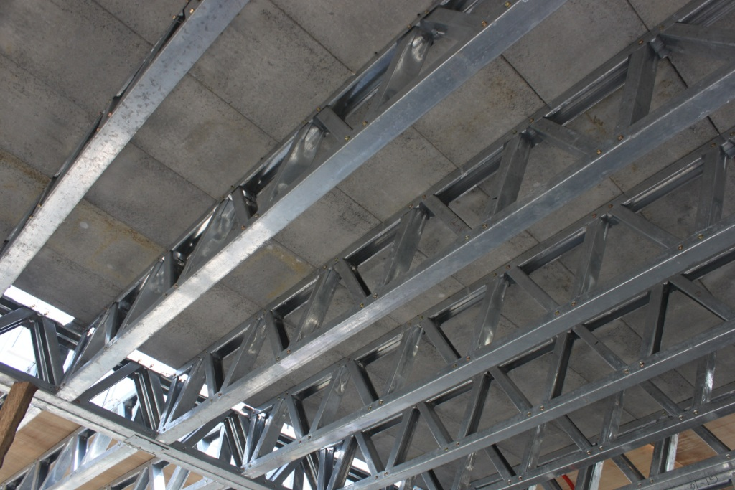
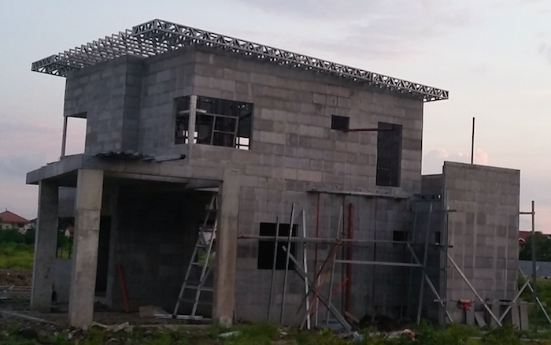
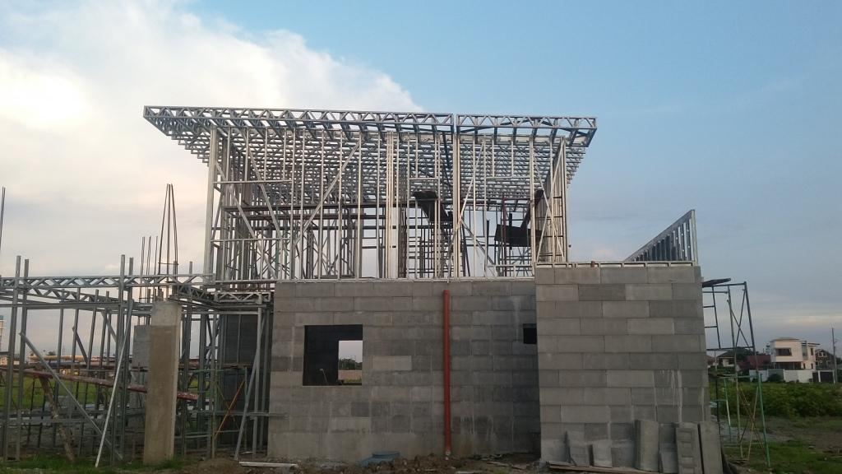
Grey Structure (Concrete Panels)

Slide 24
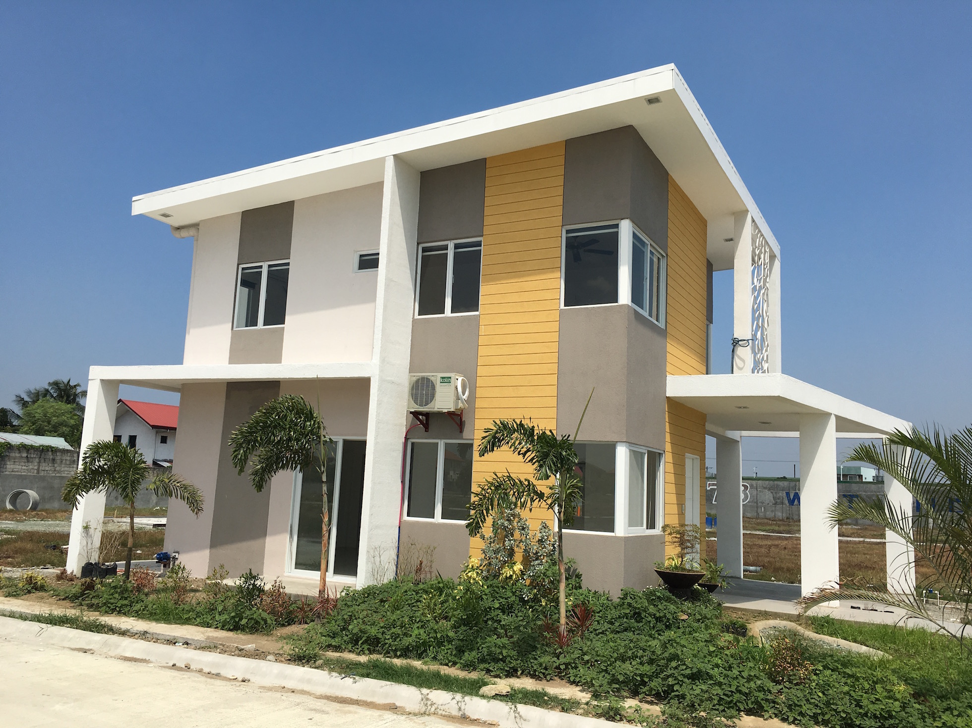
Finishing Work

Slide 25
Material Availability

Slide 26
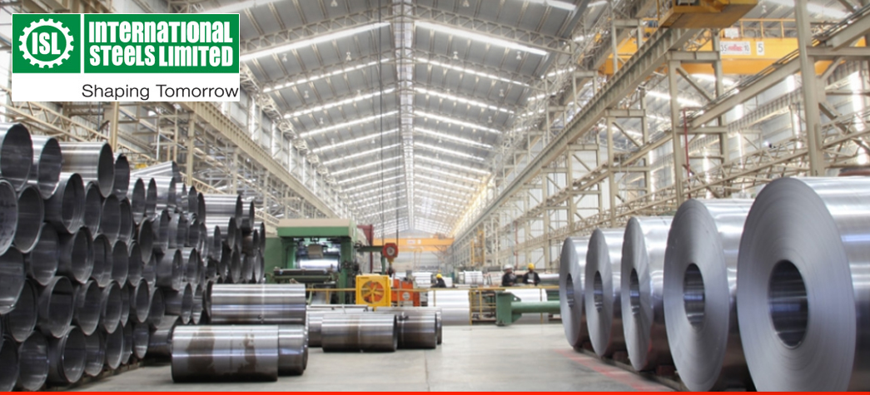
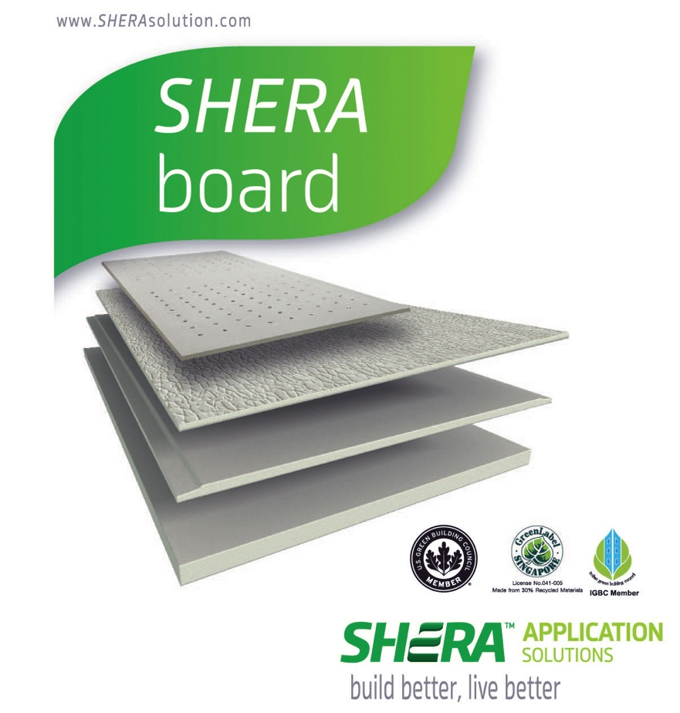
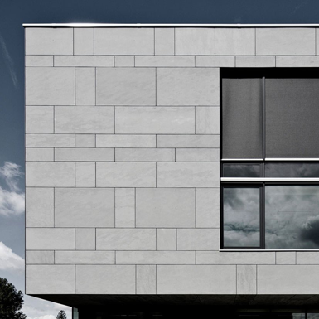
Material Availability

Slide 27
SELECTED PROJECTS

Slide 28
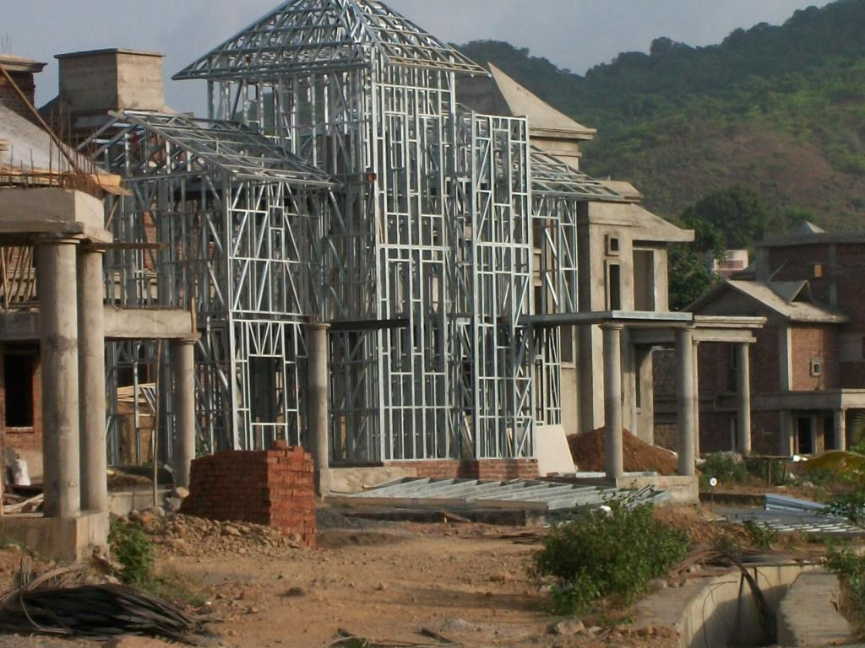
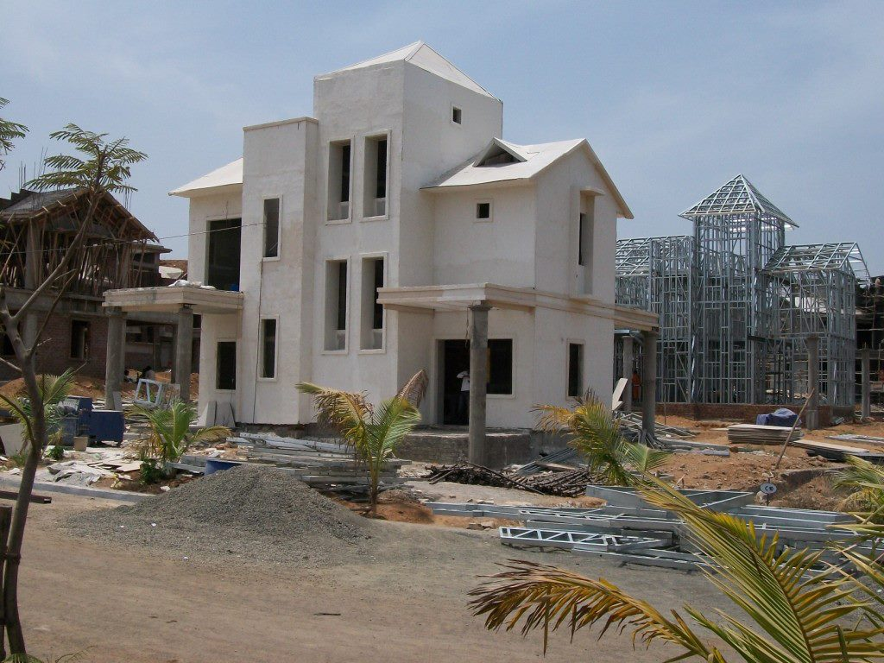
3-Story Villa, India

Slide 29
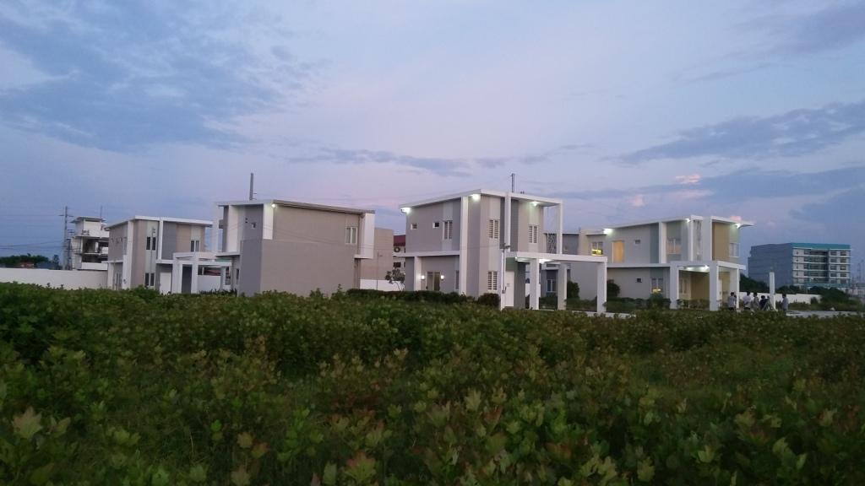
Villas

Slide 30
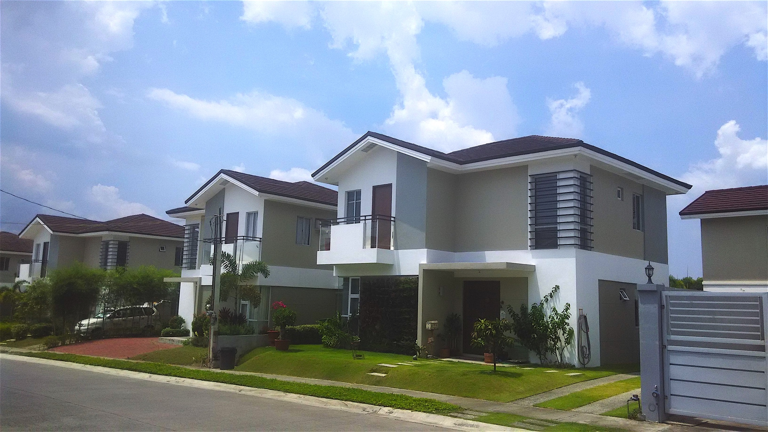
Villas

Slide 31
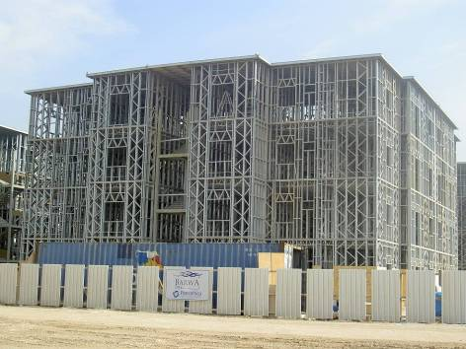
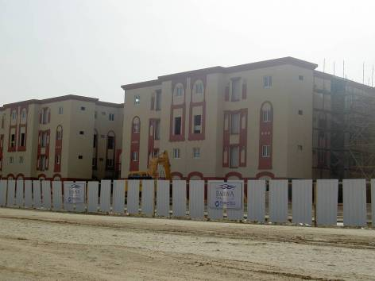
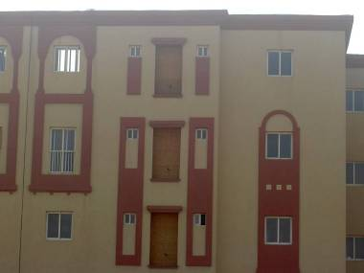
BARWA Economy/low cost Housing Project - Qatar

Slide 32
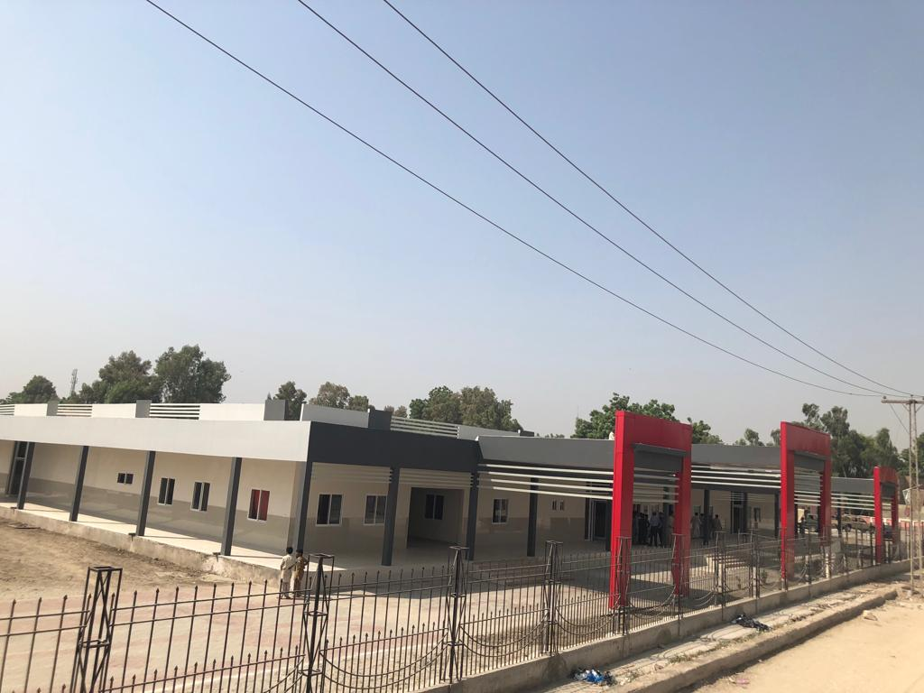
THQ Hospital Pano Aqil (50000 S.ft Completed in 6 months )

Slide 33
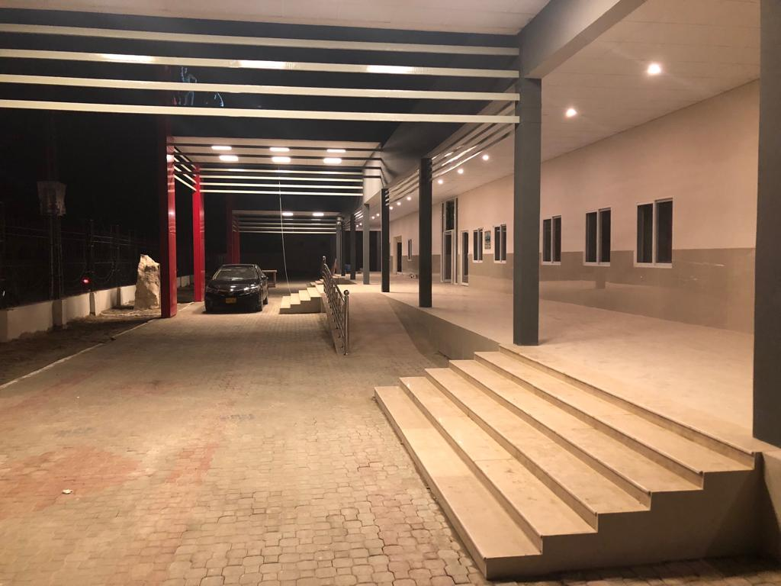


THQ Hospital Pano Aqil
(50,000 s.ft completed in 6 months)

Slide 34



THQ Hospital Pano Aqil
(50,000 s.ft completed in 6 months)

Slide 35

Data Facilitation Centers, Sindh( 27 @3000sft)

Slide 36




Board of Revenue Building, Hyderabad

Slide 37



APS at Askari-10 Rawalpindi
(30000 sft)

Slide 38



Hepatitis Clinic at PKLI Lahore.
(8500 S.ft completed in 90 days)

Slide 39




Slide 40



Hepatitis Clinic at PKLI Lahore.
(8500 S.ft completed in 90 days)

Slide 41
Key Strengths
Speed of construction
Energy Efficiency
Earth quake resistance
Dry solution
Less use of natural resources (Cement, Crush)

Slide 42
THANK YOU

