Slide 1
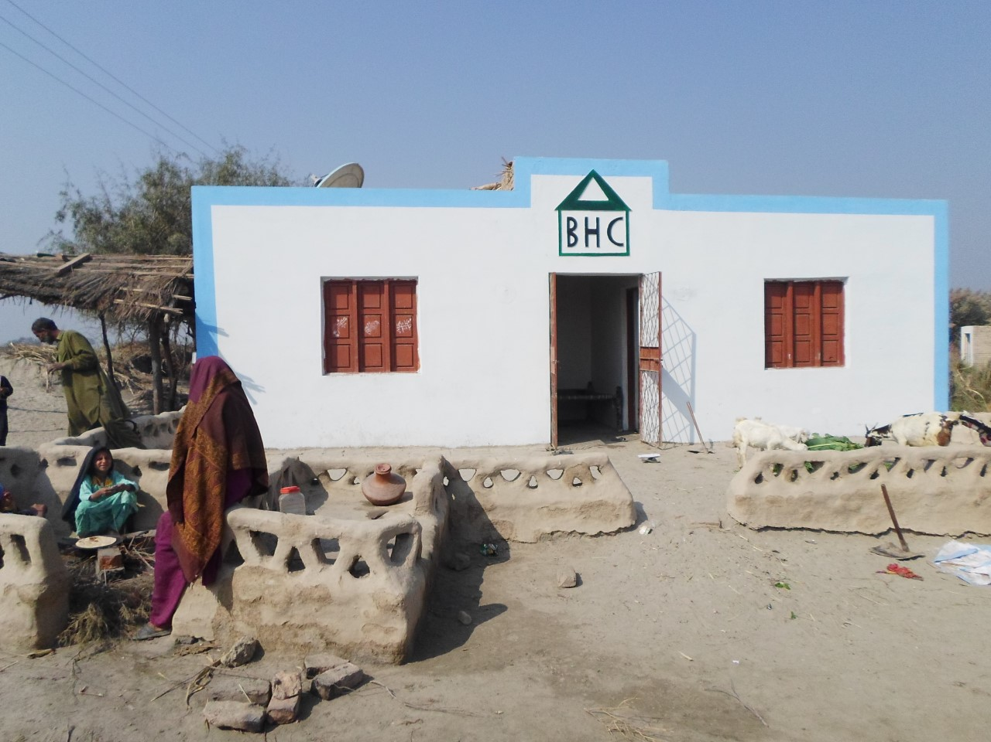
Shaheed Banazir Bhutto Housing Cell Government of Sindh
Low Cost Housing Project for the Poorest of the Poor

Slide 2
Vision& Objectives
VISION
To develop a permanent sustainable mechanism for providing housing units to the poorer sections of the society in the province of Sindh.
OBJECTIVES
To provide affordable housing units for poor house hold of the Province .
To establish a permanent sustainable institutional mechanism along with a plan to provide decent, affordable housing units for low income sections of the society.

Slide 3
SBBHC Projects
S# | Name of project | Starting Date | Completion Date | Amount Released | Amount utilized | District Name | Number of House/Plots | Progress | Remarks
1 | UNDP Project | 24-11-2008 | 2010 | 172 Million | 172 Million | Karachi , Badin , Thatta | 500 | Completed | Satisfactory
2 | SARSO Project | March 2009 | November 2009 | 50 Million | 50 million | Khairpur,Larakana, Sukkur Shikarpur , Jacobabad | 200 | Completed | Satisfactory
3 | 6000 Low cost Houses Phase I | 2010 | 2013 | 1388 Million | 1426 Million | All Districts of Province | 6000 | Not completed | Project left Some Issues due to new concept
4 | 6000 Low cost Houses Phase II | 01 -07-2014 | 15- 12 -2015 | 1570 Million | 1200 Million | All Districts of Province | 6000 | 6000 Completed | A Model Low Cost Housing Project
5 | 6000 Low cost Houses Phase III | 01-12-2016 | 9-12 Months | 1820 Millions | 450Millions | All Districts of Province | 6000 | 3000 houses will be Completed till February 2019 | Satisfactory
6 | Solar Home Project for Phase II | 01-10-2016 | 30 -02-2017 | 160 Million s | 53 Millions | All Districts of Province | 6000 | 5456 Completed | Satisfactory

Slide 4
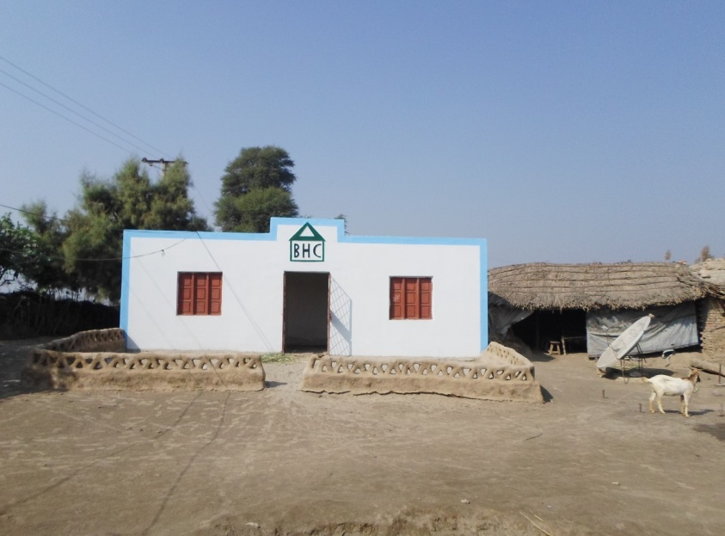
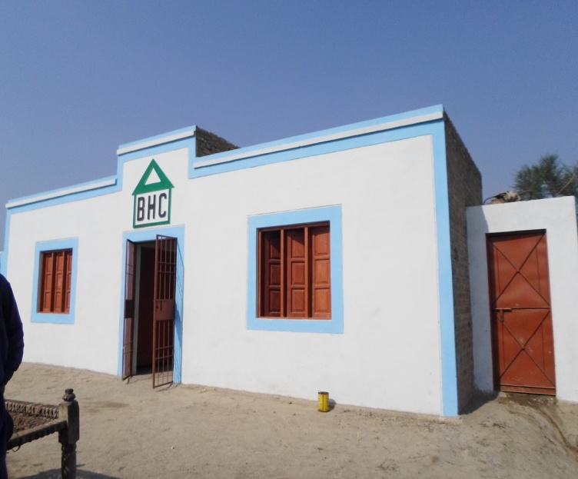
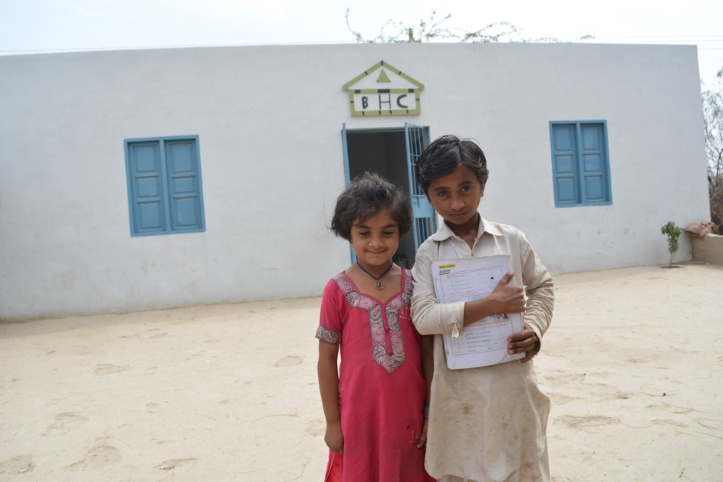
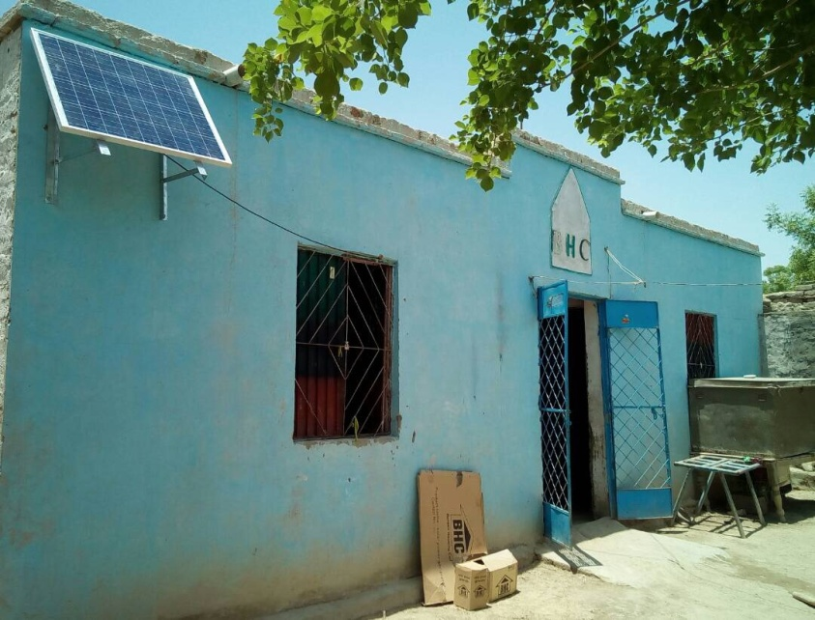
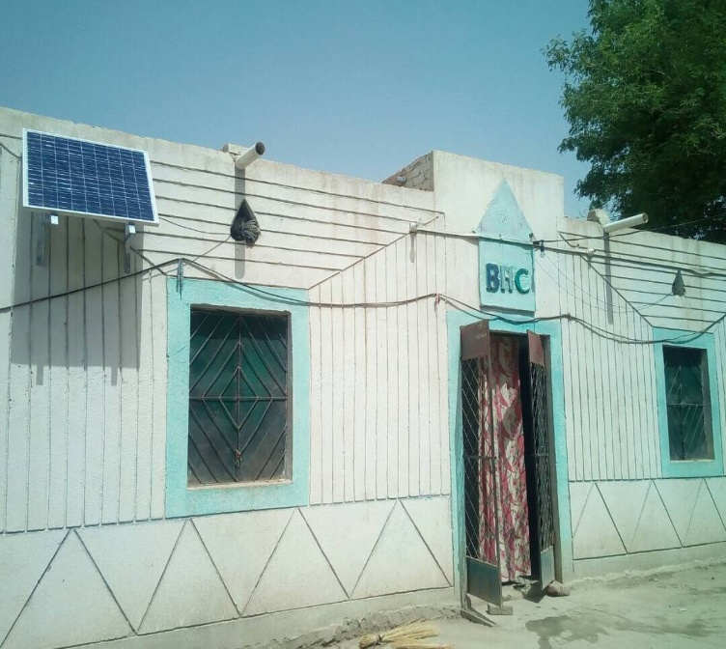
Low Cost Houses Project Phase II&III Pictures

Slide 5
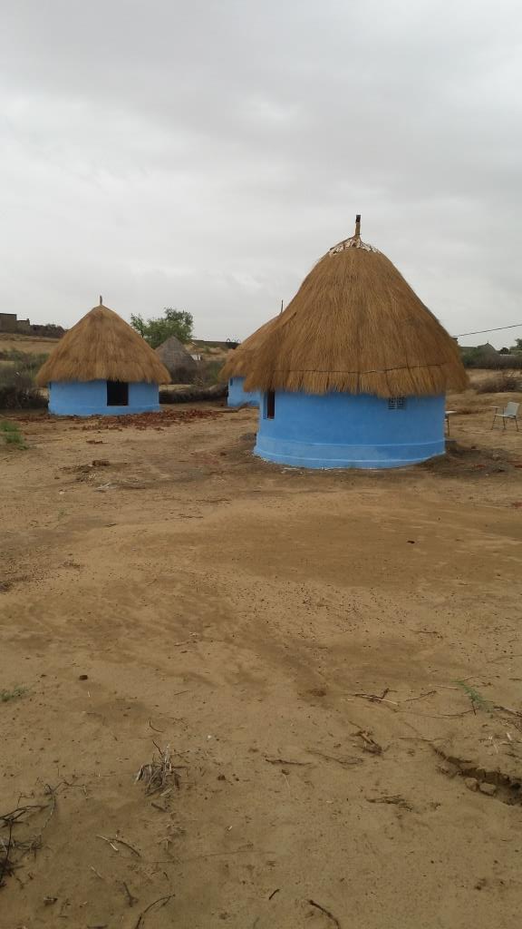
Low Cost Chowras Phase II Pictures

Slide 6
Size of Low Cost House with Cost
Low Cost House Project Phase II
Size of House and Bath Room
Two Room 10ft.x12ft. of each Corridor 5ft.x10ft. Height 10.5 ft.
Bath Room 4ft. X7ft. Height 7.5 ft. ( Total Covered Area 396 sq.ft.)
Cost of House Rs. 261000 (Rs. 659 per sq.ft. )
2. Low Cost House Project Phase III
Size of House and Bath Room
Two Room 10ft.x12ft. of each Corridor 8ft.x10ft. Height 10.5 ft.
Bath Room 4.5ft. X7.5ft. Height 7.5 ft. ( Total Covered Area 436.25 sq.ft.)
Cost of House Rs. 285700 (Rs. 655per sq.ft. )

Slide 7
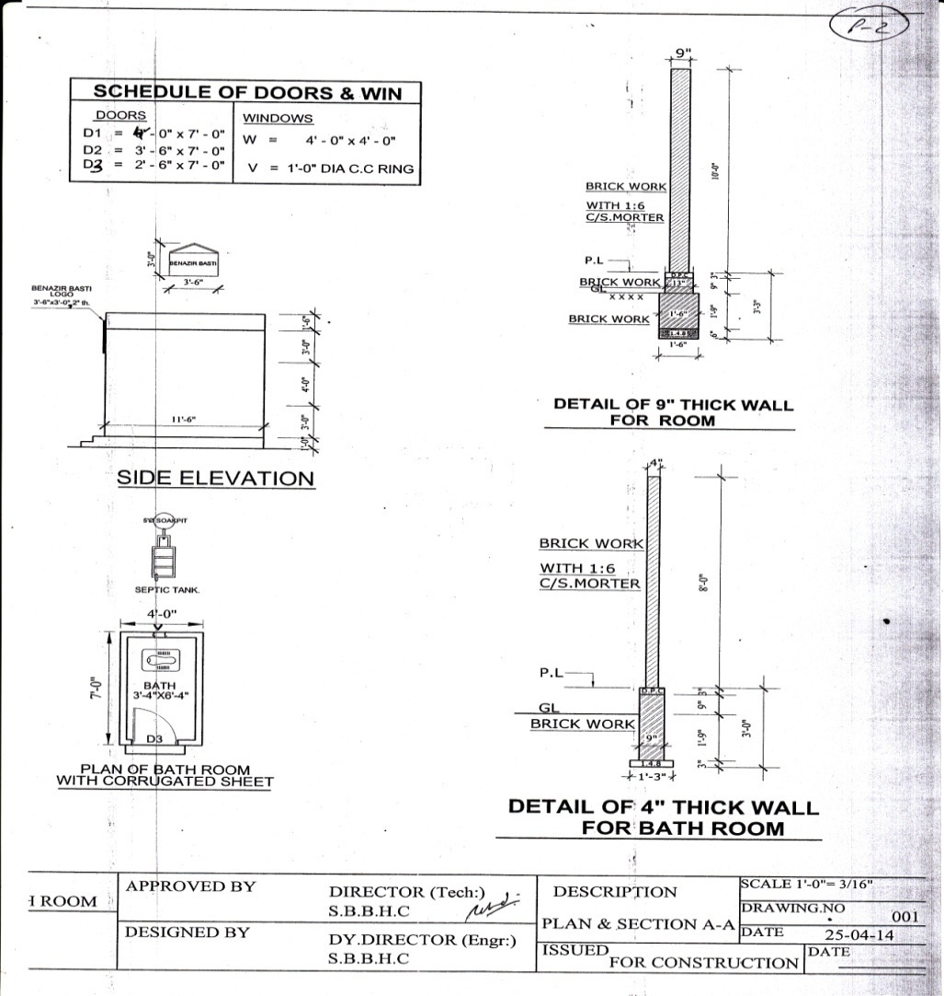
Low Cost Houses Engineering Design

Slide 8
Project Implementation Through ERP Software System
Transparent, Efficient and Time saving solution
Web based Database Management
Comprehensive System for all requirement
Accessible from anywhere
Complete Paperless System Design
Error Free Interface
Online Complain Management System

Slide 9
System Design
Beneficiary Enrolment
CSO Registration / Management
Feasibility Creation/ Forwarding to BHC
Feasibility Management by different levels
Automated Feasibility process levels(1st Feasibility to finishing level)
Complete Transaction Recording
User Management
Create or Assign User Rights
Manage Access by User
Launch any Complain from any Mobile Service or Internet Access
Financial Solutions
Automated calculations by different levels of Installments (Payment release)
Complete Financial Transactional History

Slide 10
Design Flow
BHC Solutions
CSO
Management
Beneficiary
Nomination from District
Feasibility Levels
Froward to BHC
Project Director
Finance
Engineering Dept.
Fund Release
Verification by team
Back to PD
User Management
Reports

Slide 11
Future Plans
S# | Name of project | Date of Start | Completion Period | Funds | District Name | Number of House/ Plots | Remarks
1 | 6000 Low cost Houses Phase IV | Subject to Approval | 9-12 Months | 2.50 Billions | All Districts | 6000 | Project lunch in new fiscal year 2017-18
2 | Solar Home Project for Phase III | Subject to Approval | 6 months | 2100 Millions | All Districts of Province | 6000 | Proposal Submitted to Competent Authority for Kind Approval

Slide 12
Low Cost Houses Project Phase IV Approved Design

Slide 13
SOLAR HOME
Solar Houses Proposal

Slide 14
Proposal
Product
1 DC Ceiling Fan
3 X 6Watts LED Light
1 X 150Watt Solar Panel
1 Controller with AC to DC Converter
Installation with its accessories
1 Battery Backup

Slide 15
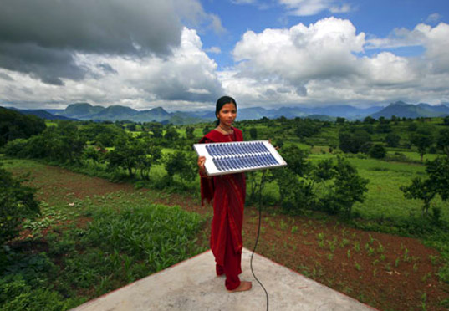
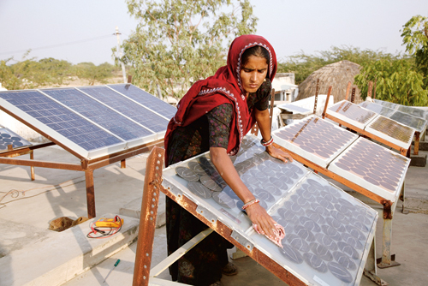
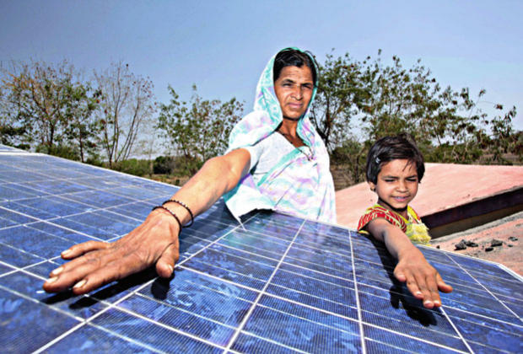
Benefits
Benazir Housing Cell proposed to install total of 6000 solar home.
Each of the Solar Home consists of a 150 watt solar panel, AC to DC Converter, and a charge controller both coupled in a box.
The system powers two 6 watt LED bulbs, a Two DC Ceiling fans and can also charge Batteries and mobile phone.
Solar Home can improve 36000 people life across Sindh province.

Slide 16
Benefits
The provision of Solar Home to villagers for electricity production gives families access to lighting and to improves their livelihoods in the rural region.
The use of solar lighting instead of kerosene lamps has positive effects on people’s health and leads to reduction of environment damaging gas emissions.
Automatic conversion can also be help to cut-down their electricity cost where sun light (alternate source) available.
Families with Solar Home are now able to enjoy alternate energy (by solar) during loadsheding hours throughout a day.
Families with Solar Home can add rechargeable battery with this system to extend the productive workday long after the sun sets.

Slide 17
Project Operations in Sindh
Districts 24
Talukas 163
Union Councils 866
Villages 3538
Number of Families 14000

Slide 18
Lesson Learned from Low Cost House Projects
Selection of Implementation Agency CSO/NGO
Beneficiary Identification
Funds Disbursement
Community Mobilization
Political Will /Support
Government Understanding towards Innovative Approach
Coordination Between Donor and Implementer
Design of House is based on the Indigenous Structure/Architecture
Low Cost ( SBBHC Rate Per sq ft 662 PKR, Government Schedule rate per sqft 1400 PKR Total cost saving From TAX Payer Money is 4442 Million almost 43 Million USD)

Slide 19
Thanks

