Slide 1


Slide 2
Food, Clothing and Shelter
It is all a number game, more the problem more the need
Fact remains that land size remains the same for a country, while land needed for producing Food, Clothing and Shelter is always on the rise due to population growth.
The world population in 1900 was around 4 billion, and today it stands at 7.67 billion.
In 1970, the population of Pakistan was 58 mn, and by 2019 it is 2001 mn.
By turn of the century it is projected at 375 mn.
The land area of Pakistan remains the same at 882,000 Sq KM.
At population at 58 mn in 1970, the density was 66 Persons/Sq KM.
Today it is 227 Persons/SqKM and by turn of the century it will be 425 Persons/SqKM.
More people to be served with food, clothing and shelter by the same land, asking for more productivity of land i.e., yield/acre for food, clothing and shelter. In housing it simply means efficient use of land through improved densification and high-rise housing.

Slide 3
Housing: beyond political sloganeering
Housing, as a political slogan, first appeared in Pakistan through Mr. Zulfiqar Ali Bhutto’s famous slogan of “Roti, Kara aur Makaan…Maang Raha hae har Insaan” which in today’s language is famous as “Housing for all”.
Then by the then PM Mr. Yusuf Raza Gilani, in his 100 Days Agenda speech, to build One Million units per year, followed by Premier Nawaz Sharif to build 5 lacs units per year.
Irony is that no institutional, administrative and legal platforms were made for execution. Therefore delivery on these promises is not visible.
PTIs’ Chairman Mr. Imran Khan made housing as part of PTI’s Election Manifesto and formally announced PTI Housing Policy.
Soon after assuming power he announced to build 50 lacs housing units over 5 years term.
The program and the policy has a focus on Affordable housing, with a defined declaration of it.
For the first time in the history of Pakistan, the program included Rural Housing as well Peri-Urban housing in the agenda.
Till such time the institutional, administrative and legal arrangements are in place, the PM has set up Housing Task Force to initiate work for delivery on the program
In addition to Federal Housing Task Force, similar set ups are being made in provinces.

Slide 4
Housing for all: The cherished mission
The target of 10 lacs housing units per year (50 lacs over 5 years tenor) will be achieved in following market segments:
Rural Areas: 4 lacs units/year
Peri-Urban areas: 2 lacs units/year
Urban Areas: 4 lacs units/year
Addressing housing issue in wider geographical and income perspective:
Rural and Peri-Urban Housing: PM program will address the rural and peri-urban housing issue, alongside the main issue of housing shortage in urban metropolitans.
Income Segments: PM Housing Program will have focus on lower-middle, low-income housing alongside housing issues of Bottom-of-Pyramid
Slums and Katchi-Abadis: Program will address slums improvement, rehabilitation and resettlement of slums/squatters, and PTI will have zero-tolerance for new squatter settlements.

Slide 5
Housing Targets: The target of 10 lac housing units a year, is to be achieved in following manner:
Low-Income Housing:
Rural Housing: 4 lacs/year (40% of target) – Moving towards decent housing/habitat
  Cost Upper Limit: Up to Rs 5 lacs
  Finance Limit: Up to Rs 4 lacs
  Supply-Side Delivery Channels: Community based self development
  Finance-Side Delivery Channels : ZTBL, Commercial Banks, Akhuwat and other eligible NGO’s
Peri-Urban areas: 2 lacs/year (20% of target)-- Moving towards decent housing/habitat etc.
  Cost Upper Limit: Up to Rs 15 lcs
  Finance Limit: Up to Rs 12.5 lacs
  Supply-Side Delivery Channels : Private Sector Developers
  Finance-Side Delivery Channels : Banks, SHFIs
Urban Areas: 5 lacs/year (40% of target)--- Mixed Habitat development by Private Sector/Developers
  Cost Upper Limit: Up to Rs 30 lacs
  Finance Limit: Up to LTV of 90:10
  Supply-Side Delivery Channels : Private Sector Developers
  Finance-Side Delivery Channels : Banks, SHFIs
Middle-Income Housing:
  Cost Limit: Up to Rs 30-100 lacs
  Finance Limit: Up to LTV of 90:10
  Supply-Side Delivery Channels : Private Sector Developers
  Finance-Side Delivery Channels : Banks, SHFIs

Slide 6
Urban Housing: Soft Launch of the Program
Punjab:
  Housing Task Force in the Province of Punjab has been announced by CM, with Mr. Yaqoob Tahir Izhar as it Chairman.
  Ministry of Housing Punjab has already initiated work on Low-Cost Housing Projects in eight cities of Punjab.
  5,000 to 6,000 houses will be announced in January, 2019 in Punjab (Lodhran, Bahawalnagar, Faisalabad and Okara).
  Similarly, there is a plan to build 10,000 houses in Sialkot, Chistian, Chiniot and Jhelum in April, 2019.
  Punjab already has institutions like PHATA, which has rights/ roles and privileges as are being considered for provincial Has but its name can be changed.
  Minister of Housing and Chairman Task Force Punjab may give further briefing on the matter.
KPK:
  PM Housing Task Force had its Meeting in Province of KPK.
  Provincial Task Force is likely to be announced soon with approval of the CM
  Land identification process has been initiated along with review of its acquisition process for the housing program
  Secretary Housing KPK may give further briefing on the matter.
Sindh:
  Some developers have already indicated to launch a few projects under Naya Pakistan Housing Program.
  Third meeting of the Task Force will be held in Karachi for initiation of the Housing Agenda in association with Sindh Govt.
  Chairman ABAD may give further briefing on this issue.
KPK, Baluchistan and Gilgit/Baltistan:
  With support from PM’s office, the Chairman Task Force will approach concerned Ministers for initiation of the program in their areas.
By: Zaigham M. Rizvi
Chairman Housing Task Force

Slide 7
Potential for Developing New Satellite Towns on State Land
Federal Govt Land with Evacuee Trust Property Board (ETPB) etc:
ETPB has a total of 110,000 acres of land in different cities which is effectively owned by Federal Govt and could be made available for developing new towns, Industrial Estates and Commercial areas for economic activates.
Some of these are
Nankana Sahib 16,000 acres: A large size city could be developed there by inviting an international developer.
Shiekhupura 4,000 acres, Sahiwal 9,600, Hyderabad 12,000 acres, Okara 12,000 acres, Layyah 5,800 acres.
Another 8-10 cities with land parcels of 1,000 to 4,000 acres.
Pakistan Railways has more than 100,000 acres
Provincial Govts have large parcels of land, which could be transformed into decent habitat, before it is grabbed by slums/mafia.
Provincial Govt land:

Slide 8
Progress on institutional arrangements
Mandwiwala & Zafar has prepared the draft bills on the following and forwarded the same to Ministry of Housing. Ministry of Housing has passed on these drafts to Law Ministry, which is expected to review and process the same for approval as required.
Housing Authority (HA)
Real Estate Regulatory Authority (RERA)
Legal matter regarding Foreclosure Law, Tenancy Law
Expected Time Line: Jan 31, 2019
Promoting Specialized Housing Finance Institutions (SHFIs):
SBP has started the work for promoting SHFIs in the private sector under DFI Model, with facilitation on capital requirements.
SBP is also actively working on restructuring HBFC to ensure its due role in low-cost housing finance.
Some commercial banks are exploring promotion of SHFIs.
National Housing Bank: SBP will go for this once there are more SHFIs in the market.

Slide 9




Balanced scorecard slide 10
Housing Research
Center
RURAL HOUSING DEVELOPMENT IN PAKISTAN

Slide 10
Steps initiated to launch Rural Housing Program
The program is for developing Model Villages of 50 housing units, befitting to the local socio-economic culture. These Model Villages will be built on 3 and 5 actress of land, with a provision for Community Center, Play Ground, Basic Health Unit and Schools for boys and girls, and cottage industry and/or suitable economic activity center.
Villages: There are 25,500 villages in Punjab only.
Target: That sets the target of 12.5 lacs rural housing units in Punjab.
Cost estimate: These houses are estimated to Cost Rs 4-5 lacs/unit
Land: It is expected that, in most of villages, the lands availability will be at no or nominal cost, relying on land parcels like “Shamilaat” lands.
Pilot Project at UMT:
Three Pilot Projects have been initiated on Rural Housing at Housing Research Center of University of Management and Technology (HRC-UMT) with active involvement of faculty and students.
Three groups of students, comprising of disciplines of Civil Engg, Architecture and Town Planning have prepared models of houses after visiting the village and studying their socio-economic norms.
After the Pilot Projects in hand in three villages succeed, the model will be expanded to all villages in Punjab and other provinces.

Slide 11
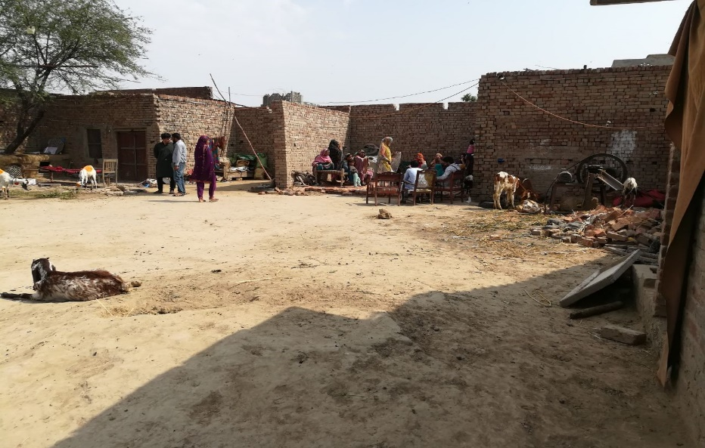
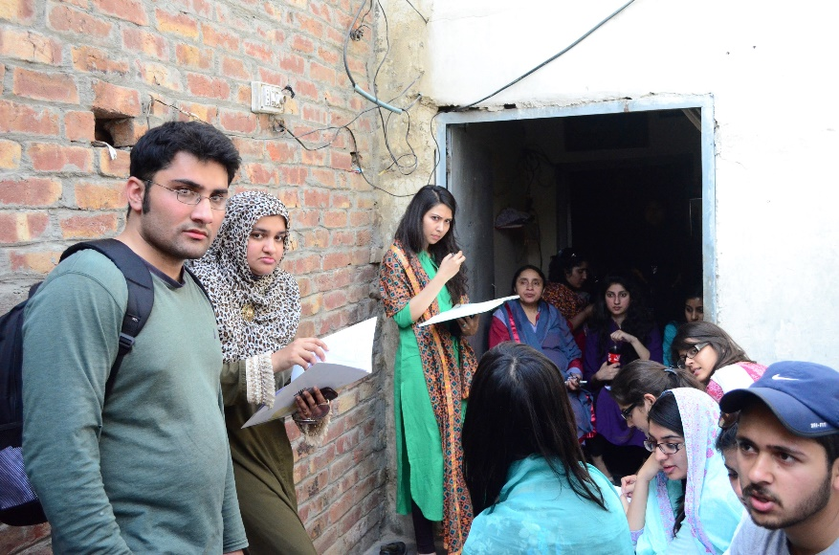
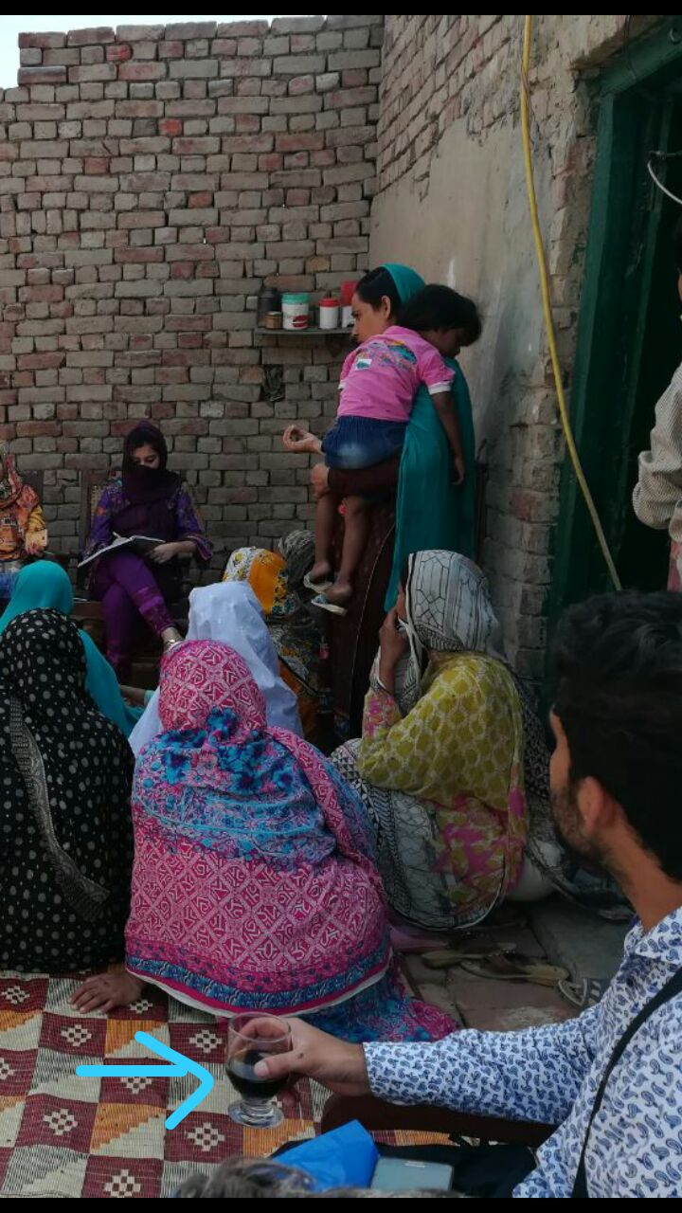
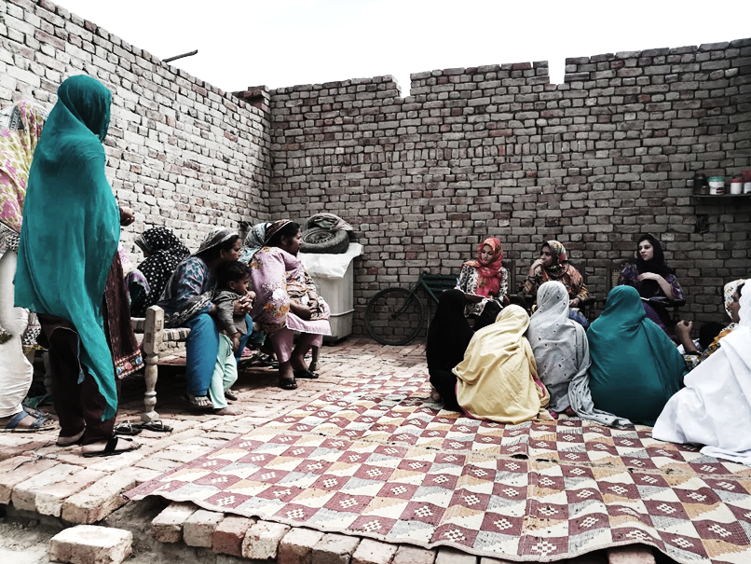
FOCUS GROUP DICUSSIONS

Slide 12
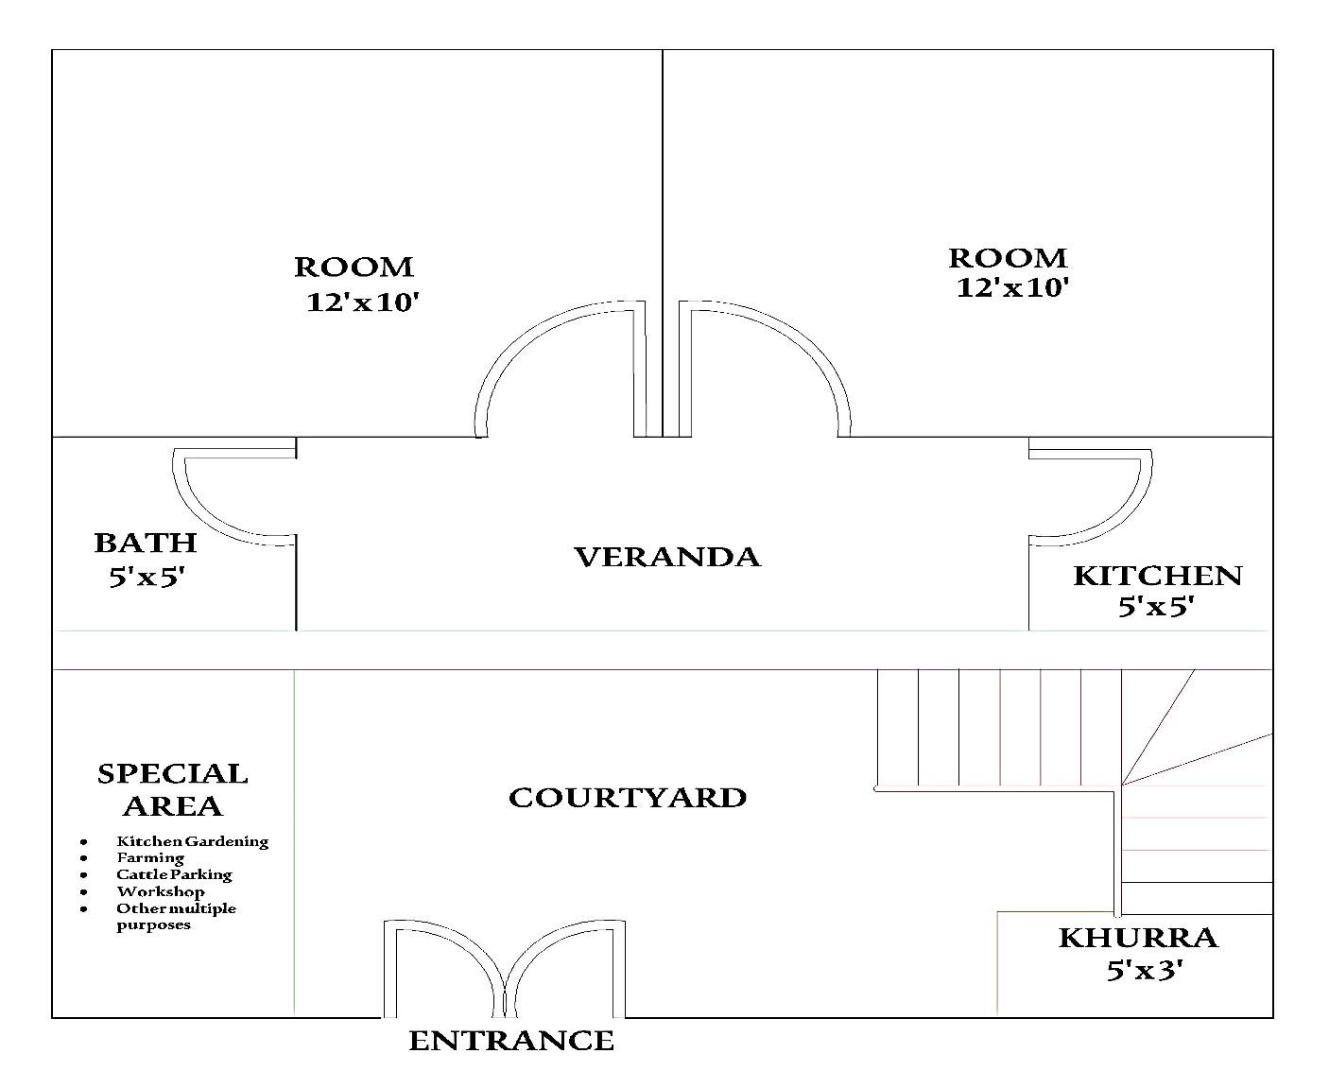
Small rural housing – cost and layout
3 Marla House
315 sqft Covered Area
315sft x Rs.1300=
Rs. 3,90,000
FEATURES
Covered Kitchen
Workshop / Shop
Grain Storage
Animal Bhara
Open Courtyard

Slide 13
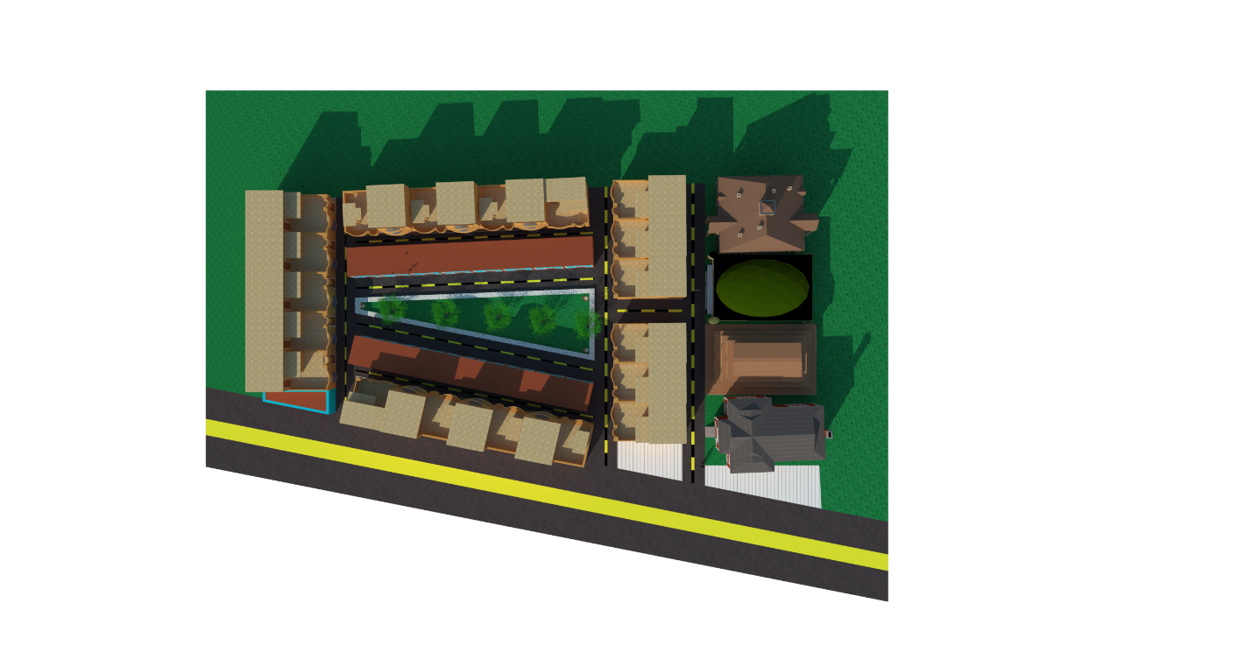
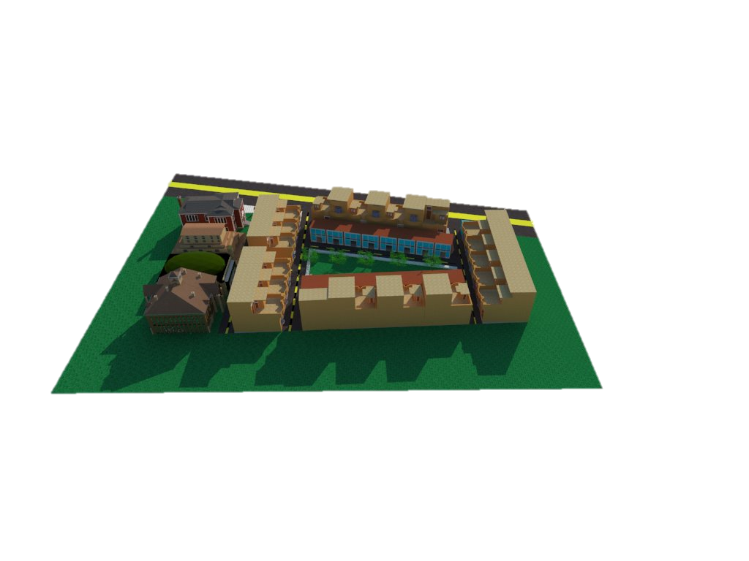
50 Houses in Rural Setting
Mera Makkan Meri Dukkan
Incrementalization
Disaster Resilient
Cost of the project of a village
50 houses x Rs. 390,000 per house
= Rs.19,500,000

Slide 14
Youth Empowerment through Rural Housing Construction
= Case of Punjab =
For construction of Model Village Housing, as per PM’s vision, un-employed graduates from disciplines of Civil Engg, Town Planning and Architecture are being mobilized by Dr. Fariha Tariq, Head HRC-UMT to form a small construction company with a capital base of Rs 4-5 mn.
Unskilled Manpower will be used from the local villages and trained by the team of professionals.
In the first stage, three such companies will be established to develop one model village each.
After successful experience of the Pilot Phase, the project will be expanded from Pilot Scale to Commercial Scale by expanding its outreach to the entire province with involvement of more Universities and Government agencies like National Rural Support Programme (NRSP).
Employment Potential of a project:
  Professional: 5
  Skilled Manpower: 50
  Unskilled: 250
  Delivery
  Delivery: Two Model Villages/team/year
  Target 5,000 model villages/year
  Overall: 7-8 lac
Time Line for initiation of three pilots projects:
Jan 31, 2019
By: Zaigham M. Rizvi
Chairman Housing Task Force

Slide 15
Peri-Urban Housing for Bottom-of-Pyramid
Qarde-Hasana Loans on Akhuwat Model
PM has already announced Rs 5 bn for Qarde Hasana Loans through Akhuwat Foundation and other such NGOs.
Target market for such loans is very poor segment of the population living in low-income habitat
Under this model under PM Housing Program, Akhuwat has already identified about 15,000 clients for housing microfinance, and has started financing to such deserving people.
Finance Minister has directed Benazir Income Support Programme (BISP) to manage disbursement of these loans and their follow-up/monitoring.
BISP is expected to soon initiate the process of selection and disbursement through Akhuwat Foundation, NRSP and other eligible NGOs meeting specified criteria.
Akhuwat is targeting to support/develop 150,000 housing in its first year, once the funding is available.
Slums Rehabilitation and Resettlement:
At some later stage, program will expand to cover this segment.

Slide 16
Promising role of Academia in research and advisory on Construction Materials, Construction Technologies
In Pakistan there is a big gap between academia and the field practitioners, while globally Academia is the primary source and driver for technological innovations. We have taken an initiative to bridge this gap by establishing housing research and advisory centers at different universities.
NEDUET Karachi: Center for Affordable Housing and Sustainable Development- NEDUET Karachi
UMT-Lahore: Housing Research Center-University of Management & Technology Lahore
UET Lahore: Housing Research and Advisory Center-UET Lahore
UET-Peshawar: UETP is doing a great job in development of low cost construction materials and disaster resilient housing
These universities have Departments of Civil Eng., Architecture and Town Planning, staffed by PhDs, and a large number of students. The students are already being given Research Thesis on related areas on Naya Pakistan Housing Programme. Some of these topics are:
Design of Rural Housing Program-UMT Lahore
Low-Cost Construction Material - NEDUET Karachi
Alternate design of low-cost housing and habitat – UET Lahore
And more such areas will be added.
Youth Economic Empowerment: These students are routinely consulting their faculties and at times myself to improve quality of their work. They all are so excited being a part of reconstruction of Naya Pakistan and their future.

Slide 17
Housing Finance, Developer Finance Models and Fiscal Incentives
Regulatory Incentives to Banks/SHFIs: State Bank of Pakistan has already finalized the regulatory incentives for Banks/DFIs to encourage low-cost housing finance in the country. Besides, SBP has also developed a refinance scheme for low cost housing for special segments.
Housing Finance and Builder Finance Models: SBP has also been extending its support to Housing Task Force and its Working Group on Finance for developing the financing models for homeowners and builders under Naya Pakistan Housing Program (NPHP). The Task Force in consultation with SBP, is in advance stage of finalizing NPHP’s financing models.
Long-Term Funding: SBP has worked out its long term funds availability plan over the next 5 years to ensure availability of funds.
Finance Ministry has, in principle, approved some fiscal incentives for promotion of low cost housing and housing finance. Announcement is expected in January.
Announcement: As regards announcements of regulatory and financial incentives as well as refinance scheme, SBP has requested for a suitable date and time of availability of honorable Prime Minister / Finance Minister so that the launching ceremony for these incentives be planned accordingly
  Time Line: Jan 15,2019
By: Zaigham M. Rizvi
Chairman Housing Task Force

Slide 18
Sponsor a Shelter Foundation:
A Web-based platform is being developed to provide financial assistance to needy and poor segments for their economic empowerment for buying a house beyond their means.
Platform will be called “Sponsor a Shelter Foundation” and will work under the management of Housing Authority.
Such a financial support may come from wealthy people, willing to assist shelterless poor in the following forms:
  Upfront Cost Support: A donor may assist a poor by meeting a part of the upfront cost, so that the balance amount through bank loan is within his repayment capacity.
  Support in monthly loan installments: A donor may come forward and pledge a part of the regular housing installment for a certain period, such that the remaining loan installments get within the repayment eligibility of the client.
The poor seeking financial assistance will place their request for financial assistance on the website through the office of HA. For low-income housing, the amounts of donations needed may be in the range of Rs 5-10-15 lacs/client. A donor may split his donation to more than one low-income clients for housing.
The potential donors will be invited to visit the website and pledge their donations on case to case basis.
  An initial survey on this has received very encouraging response from the potential donors, due to the believe that, providing a house to needy and poor in this world, will bless them a house in Jannat.
  If one percent of the Pakistanis, who are elites of the elites, i.e., two million people come forward, the program will get support for 20 lacs housing units. The Program will ensure that donation will positively go for providing house while respecting the honor of the client.
  The donors will have all the mechanisms in their hands to ensure that, their donations have been used rightly.

Slide 19
Other initiatives
Land Bank Information Repository…Google Pin location on the map
Promising Interest of Foreign Developers/Investors for manufacturing Stage Production of Housing
Reception Desk and Facilitation Center at Beard of Investment (BoI) for Foreign Developers/Investors in housing
Backward integration with Industry for large scale production of construction materials, like Cement, Steel, Doors/Windows, Sanitary Wares, Cables etc
Standardization of sizes so as to facilitate large scale production and sale through recognized outlets….“Home Depot” Concept
Solar Power through retail options as well as Mini-Grids

Slide 20

Striving, in-sha-Allah, for:

